Slide 1
The Survival of Export Links for Türkiye
Didem Yazıcı (CBRT)
Elif Akbostancı Özkazanç (METU)

Slide 2
Outline
Aim & Scope
Literature
Methodology
Data
Results
  Non-parametric
  Parametric
Conclusion

Slide 3
Aim & Scope
The aim of this paper is to analyze the patterns and the determinants of export survival for Türkiye in a new perspective.
Contract survival (firm-product-destination triplets)
Scope:
  Period between 2010 and 2020
  Firms operating in manufacturing sectors (corresponding to sectors between 10-32 in 2-digit NACE sectoral classification)
  39,709 firms and 2,702,759 contracts

Slide 4
Literature
Pioneer study Besedes and Prusa (2006)
  Trade durations are short and fleeting
Sabuhoro and Gervais (2006)
Perez et al. (2007)
Inui et al. (2017)
Stirbat et al. (2013)
Arguello et al. (2020)
Esteve‐Pérez (2021)

Slide 5
Literature
Studies for Türkiye in the Literature
Author | Analyzed Period | Estimation Method | Data Used | Unit of the Analysis
Pişkin (2017) | 1998-2013 | Discrete-time probit, logit and cloglog hazard models and continuous time Cox proportional hazard model | CEPII-BACI data set | Product-Country
Atabek Demirhan (2016) | 1989-2010 | Discrete time duration models | CBRT Company Accounts dataset | Firm
Türkcan (2016) | 1998-2013 | Discrete time duration models | CEPII-BACI data set | Product-Country
Saygılı and Türkcan (2017) | 1998-2013 | Discrete time duration models | CEPII-BACI data set | Product-Country

Slide 6
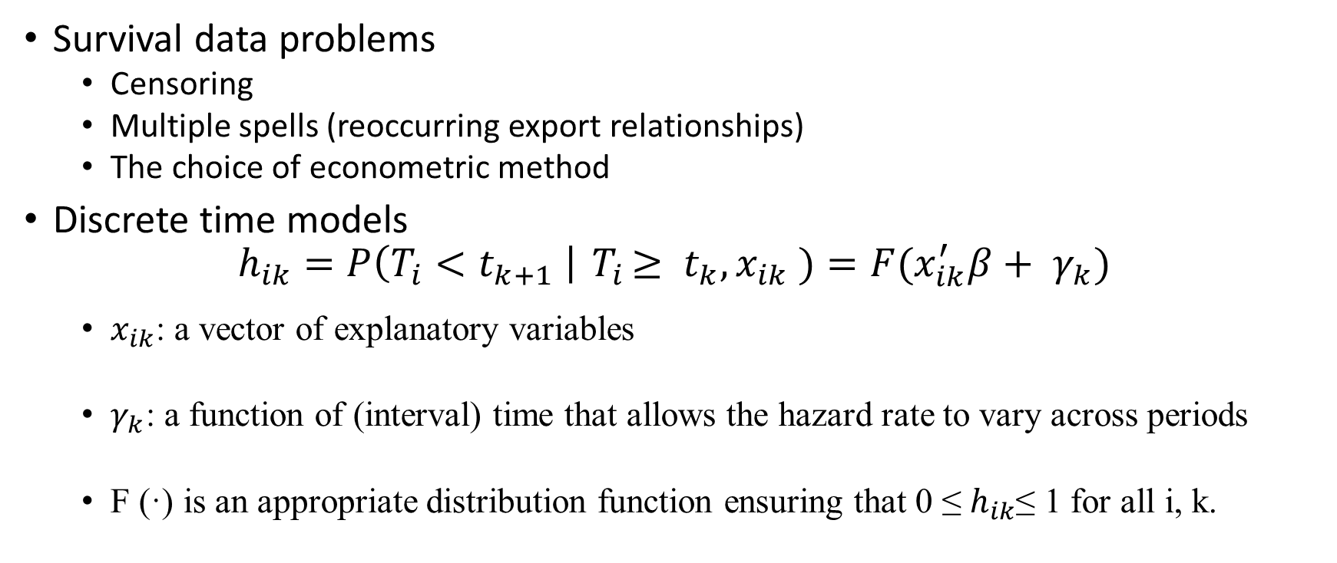
Methodology
Survival data problems
  Censoring
  Multiple spells (reoccurring export relationships)
  The choice of econometric method
  Discrete time models
  $$h_{ik}=P\left(T_{i}<t_{k+1} \right|{ T}_{i}≥ t_{k}, x_{ik} )=F(x_{ik}^{′}β+ γ_{k})$$
  $x_{ik}$: a vector of explanatory variables
  $γ_{k}$: a function of (interval) time that allows the hazard rate to vary across periods
  F (·) is an appropriate distribution function ensuring that 0 ≤ $h_{ik}$≤ 1 for all i, k.

Slide 7
Data
Transaction level Turkish customs data shared by the Ministry of Trade with the CBRT
Annual balance sheets and income statements data of Turkish non-financial firms, which is shared by the Turkish Revenue Administration with CBRT
Gravity data set by CEPII
Comtrade database by UN
GDP by country data by the World Bank

Slide 8
Variables: Contract Survival
Variable | Description
EUfirst | 1 if the company's first export country is one of the EU countries, 0 otherwise
samedestimp | 1 if the company has previously imported from the country it exports to, otherwise 0
otherdestimp | 1 if the company has previously imported from a country other than the country it exports to, otherwise 0.
sameprod | 1 if the company exports the product it exports before, otherwise 0
samedest | 1 if the company has previously exported to the country it exports to, otherwise 0
famwithprod | The number of countries to which the company exported its products in that year
famwithdest | Number of products exported by the company to the country it exports to in that year
peers | The number of companies that exported to the product-country pair that the company exported that year
RCA | Dummy with 1 for products with RCA (revealed comparative advantage) greater than 1, 0 for others
logdistance | Logarithm of the distance between the country of export and the destination
loginitialvalue | Logarithm of the company's first export value of the product-country pair it exports to
loggdp | Logarithm of the real GDP of the destination country
loggdppercap | Logarithm of the destination country's real GDP per capita
GDPgrowth | Real GDP growth of the destination country

Slide 9
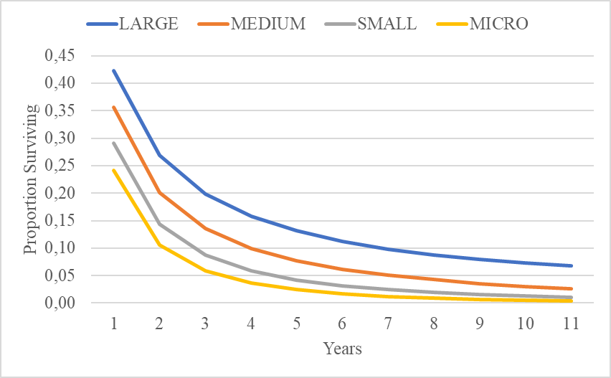
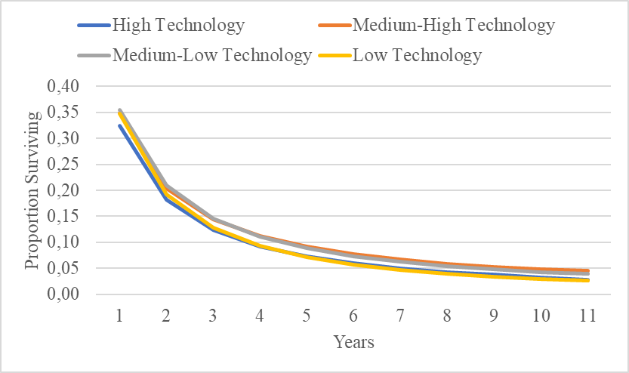
Non-parametric results
High technology sectors have the lowest survival rates at first three years.
After one year of exporting, 42% of FPDs with large firms, 36% of FPDs with medium firms, 29% of FPDs with small firms, and 24% of FPDs with micro firms can survive in export markets.
Notes:
After one year of exports, 89 percent of large companies can survive in export markets, while 62 percent of micro companies can survive.
While 57 percent of large companies can survive after 10 years of exports, only 8 percent of micro companies can survive in export markets.
As for FPDs, after one year of exporting, 42% of FPDs with large companies and 24% of FPDs with micro companies can survive in export markets. After 10 years of exporting, 7% of FPDs with large firms survive, while almost none of FPDs with small firms survive.

Slide 10
Non-parametric results
Table 5.1.3: Regional Survival Rates
Years | East Asia and Pacific | Europe and Central Asia | Latin America and the Caribbean | Middle East and North Africa | North America | South Asia | Sub-Saharan Africa
1 | 0.36 | 0.36 | 0.40 | 0.33 | 0.38 | 0.34 | 0.30
2 | 0.21 | 0.21 | 0.24 | 0.18 | 0.22 | 0.20 | 0.16
3 | 0.15 | 0.15 | 0.18 | 0.12 | 0.16 | 0.14 | 0.10
4 | 0.11 | 0.11 | 0.14 | 0.09 | 0.13 | 0.10 | 0.08
5 | 0.09 | 0.09 | 0.11 | 0.07 | 0.10 | 0.08 | 0.06
6 | 0.08 | 0.07 | 0.10 | 0.05 | 0.09 | 0.07 | 0.05
7 | 0.06 | 0.06 | 0.08 | 0.04 | 0.07 | 0.06 | 0.04
8 | 0.06 | 0.05 | 0.07 | 0.04 | 0.07 | 0.05 | 0.03
9 | 0.05 | 0.05 | 0.07 | 0.03 | 0.06 | 0.04 | 0.03
10 | 0.04 | 0.04 | 0.06 | 0.03 | 0.05 | 0.03 | 0.03
11 | 0.04 | 0.04 | 0.05 | 0.02 | 0.05 | 0.03 | 0.02
Source: Author's calculations
Notes:
FPDs in Latin America and the Caribbean have the highest survival rates. After one year of exporting, 40% of FPDs in this region can survive.
In Europe and Central Asia, Turkey's largest trading partner, 36% of FPDs can survive after one year of exports. These results may be due to the high competitiveness in Europe, both among Turkish companies and between Turkish companies and their foreign competitors.

Slide 11
Parametric Results: Contract Survival
VARIABLES | Model 1 Random Effects Logit | Model 2 Random Effects Logit | Full Model Random Effects Logit | Full Model Logistics Model | Full Model Cox
EUfirst | 1.438*** | 1.433*** | 1.348*** | 1.409*** | 1.100***
 | (0.00655) | (0.00654) | (0.00612) | (0.00517) | (0.00121)
samedestimp | 0.775*** | 0.792*** | 0.861*** | 0.838*** | 0.928***
 | (0.00408) | (0.00417) | (0.00460) | (0.00313) | (0.00171)
otherdestimp | 1.068*** | 1.061*** | 0.971*** | 0.984*** | 1.000
 | (0.00401) | (0.00399) | (0.00359) | (0.00264) | (0.00115)
sameprod | 0.545*** | 0.549*** | 0.590*** | 0.461*** | 0.825***
 | (0.00198) | (0.00200) | (0.00214) | (0.00130) | (0.000705)
samedest | 0.885*** | 0.892*** | 0.877*** | 0.664*** | 0.872***
 | (0.00313) | (0.00316) | (0.00310) | (0.00184) | (0.000752)
familiaritywithprod | 0.948*** | 0.947*** | 0.950*** | 0.960*** | 0.979***
 | (0.000144) | (0.000145) | (0.000143) | (0.000104) | (0.0000679)
familiaritywithdest | 0.998*** | 0.998*** | 0.996*** | 0.997*** | 0.999***
 | (0.000035) | (0.000035) | (0.0000348) | (0.0000270) | (0.0000126)
numberofpeers |  | 0.998*** | 0.998*** | 0.999*** | 0.999***
 |  | (0.0000255) | (0.0000251) | (0.0000180) | (0.00000965)
RCAdummy |  |  | 0.958*** | 0.964*** | 0.984***
 |  |  | (0.00289) | (0.00207) | (0.000887)
logdistance |  |  | 1.315*** | 1.252*** | 1.082***
 |  |  | (0.00324) | (0.00211) | (0.000800)
loginitialvalue |  |  | 0.840*** | 0.866*** | 0.953***
 |  |  | (0.000478) | (0.000332) | (0.000146)
logdestgdp |  |  | 0.933*** | 0.944*** | 0.979***
 |  |  | (0.00110) | (0.000784) | (0.000348)
logdestgdppercap |  |  | 0.933*** | 0.947*** | 0.984***
 |  |  | (0.00155) | (0.00111) | (0.000497)
GDPgrowth |  |  | 0.994*** | 0.995*** | 0.998***
 |  |  | (0.000228) | (0.000186) | (0.0000635)
Constant | 6.317*** | 6.421*** | 28.90*** | 20.36***
 | (0.0832) | (0.0847) | (0.796) | (0.386)
Observations | 4,907,889 | 4,907,889 | 4,898,241 | 4,898,241 | 4,898,241
Number of FPDs | 2,708,302 | 2,708,302 | 2,702,759 | 2,702,759 | 2,702,759
Standard errors are robust and clustered on FPDs.
All models include time, firm size and sectoral technology level dummies.
*** p<0.01, ** p<0.05, * p<0.1
Notes:
First, experience-related variables other than exporting to the EU market reduce the hazard rate of export exit. The strongest effect comes from previous exports of the same product. If a company has exported the same product before, the risk of exiting export markets decreases by 41%.
The first export to the EU market increases the exit risk by 34 percent. This may be an unexpected result, but it is consistent with other studies on the survival of Turkey's exports (Türkcan, 2016; Pişkin, 2017). This result may be due to the fact that Turkish companies have been exporting to the Middle East and African countries in recent years and that Turkish exports consist of low and medium technology products for which there is high competition from Asian countries (Pişkin, 2017).
The effects of other variables are also as expected. RCA, initial export value, target country's GDP, GDP growth, and GDP per capita have positive effects on survival, while distance to the target country has negative effects.

Slide 12
Conclusion
The role of trade experience
Survival rates for firm-product-destination triplets are low
Prior experience matters, particularly experience with exporting the same product or to the same destination
First exporting to the EU market increases the risk of exiting
Policy implications
  Facilitating access to credit and export financing
  Investing for equipping firms with necessary skills and knowledge
    Easing market research and supporting enterprises in facing challenges of specific export destinations

Slide 13
Thank You!

