Slide 1

The benefits of Schengen Area membership in the CEE countries. A synthetic approach
Horatiu Lovin, Vlad Voinescu, Bogdan Munteanu
National Bank of Romania
XXII European System of Central Banks' Emerging Markets Workshop, Valencia, November 27-28, 2025
The opinions expressed herein are those of the authors and do not necessarily reflect the views of the National Bank of Romania.

Slide 2
1. Context and motivation
Geopolitical risk has intensified in the EU since 2022, particularly in the countries situated in the vicinity of Ukraine
Mounting barriers against global trade jeopardize the economic outlook in the EU
During 2023-2025, the Schengen Area enlarged with three new members from CEE (Croatia, Bulgaria and Romania)
Cross-border integration and free mobility bring undeniable economic benefits
Some Schengen Area members introduced temporary border controls in a period when other EU countries made efforts to join the Area

Slide 3
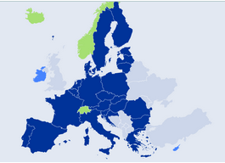
2. Schengen Area
1985: Schengen Area was formally born; 10 members from the European Economic Community (gradual abolition of border checks)
1990: Implementation of Schengen convention (freedom of movement of people, goods and services)
1997: Adoption of the Treaty of Amsterdam and the Schengen acquis (integration into the framework of the EU)
2025: 29 members (25 EU MS and 4 EFTA countries)
Source: Council of the European Union, 2025, https://www.consilium.europa.eu/en/policies/schengen-area/

Slide 4
3. Benefits of Schengen Area membership
Direct benefits
Lower transportation costs
Better consumer prices due to higher competition and less trade frictions
Increased economic activity near borders
Spillovers effects for tourism
Lower budgetary spending on internal border control
Indirect benefits
Cross-border supply chain optimization
Economic, trade and labour market integration
Reduction of internal market fragmentation
Better use of trade connectivity networks
Sources: Aussilloux and Le Hir, 2016; Böhmer et al., 2016; Davis and Gift, 2014; Felbermayr et al., 2017; Parenti and Tealdi, 2019

Slide 5
3. Benefits of Schengen Area membership (cont.)
    Trade expansion
      Trade increase by 2.81%, on top of the EU’s trade effect - Felbermayr et al. (2017)
      Trade growth by 13%-20% over the long run - Mayer and Umana-Dajud apud. Aussilloux and Le Hir (2016)
      Decrease of trade by 10.5%-12.5% if rolling back Schengen Area – CEPII (Centre d'Études Prospectives et d'Informations Internationales) apud. Aussilloux and Le Hir (2016)
    Lower prices
      Trade effect equivalent with a tariff decline of 0.46%-1.02% - Felbermayr et al. (2017)
      Shadow tax of 3% on traded goods if border controls are introduced -Umana-Dajub and Mayer, apud. Aussilloux and Le Hir (2016)
      Increase of import prices between 1% and 3% if Schengen border controls are reintroduced - Böhmer et al. (2016)

Slide 6
3. Benefits of Schengen Area membership (cont.)
    Increased revenues for freight companies and tourism industry
      Potential losses for tourism between 10 and 20 billion EUR per year, 7.5 billion EUR extra-costs for road transporters if “Non-Schengen”– European Parliament (2016a)
    Reduced public costs of border controls
      Additional costs between 5 and 18 billion EUR if border controls are reintroduced in the Schengen Area – European Commission (2016)
    Higher GDP
      EU GDP loss of 0.14% annually if Schengen Area suspended – European Parliament (2016b)
      GDP decline by 0.86% in case border controls are reintroduced (-0.50% in France and -0.80% in the EFTA countries) – Aussilloux and Le Hir (2016)

Slide 7
4. Real convergence of the CEE countries
GDP per capita at PPS in the CEE countries (% of EU average)
More than two decades of economic convergence to the EU standards of the CEE countries, currently at approx. 80% of EU average
The development gap between 2004 and 2007 EU accession country groups has narrowed significantly
The EU membership has been the main growth driver in the CEE countries, but the participation in the Schengen and Euro Areas contributed, as well
Note: CEE countries that are only EU and Schengen Area members (since December 2007): Czech Republic, Hungary and Poland; CEE countries which are EU, Schengen Area and Euro Area members: Croatia, Slovak Republic, Slovenia, Estonia, Latvia and Lithuania.
Source: Eurostat, authors’ calculations.

Slide 8
5. Trade integration of the CEE countries
The CEE countries that joined the Schengen Area in 2007 have more open economies, but all countries in the region fallowed a similar trade path; the EU membership has driven the trend, whereas the Schengen Area membership may have supported deeper trade integration
Exports/GDP
Imports/GDP
Note: CEE countries that are only EU and Schengen Area members (since December 2007): Czech Republic, Hungary and Poland; CEE countries which are EU, Schengen Area and Euro Area members: Croatia, Slovak Republic, Slovenia, Estonia, Latvia and Lithuania.
Source: Eurostat, authors’ calculations.

Slide 9
6. Data sample
Accession of the CEE countries to the European integration areas
 | European Union | Schengen Area | Euro Area
Romania | January 2007 | January 2025 | -
Bulgaria | January 2007 | January 2025 | January 2026
Croatia | July 2013 | January 2023 | January 2023
Czech Republic | May 2004 | December 2007 | -
Hungary | May 2004 | December 2007 | -
Poland | May 2004 | December 2007 | -
Slovakia | May 2004 | December 2007 | January 2009
Slovenia | May 2004 | December 2007 | January 2007
Estonia | May 2004 | December 2007 | January 2011
Latvia | May 2004 | December 2007 | January 2014
Lithuania | May 2004 | December 2007 | January 2015

Slide 10
7. Model
Synthetic DID (Arkhangelsky et al., 2021; Clarke et al.,2023) – enhances causality assessment
Covariates and domestic economic policies control for other GDP growth drivers
Common factors with heterogeneous effects (Bai, 2009; Bai and Ng, 2017)
No “bad controls” (Angrist and Pischke, 2009); covariates not corelated with Schengen Area membership
Variance adjustments of GDP growth data during the COVID-19 pandemic

Slide 11
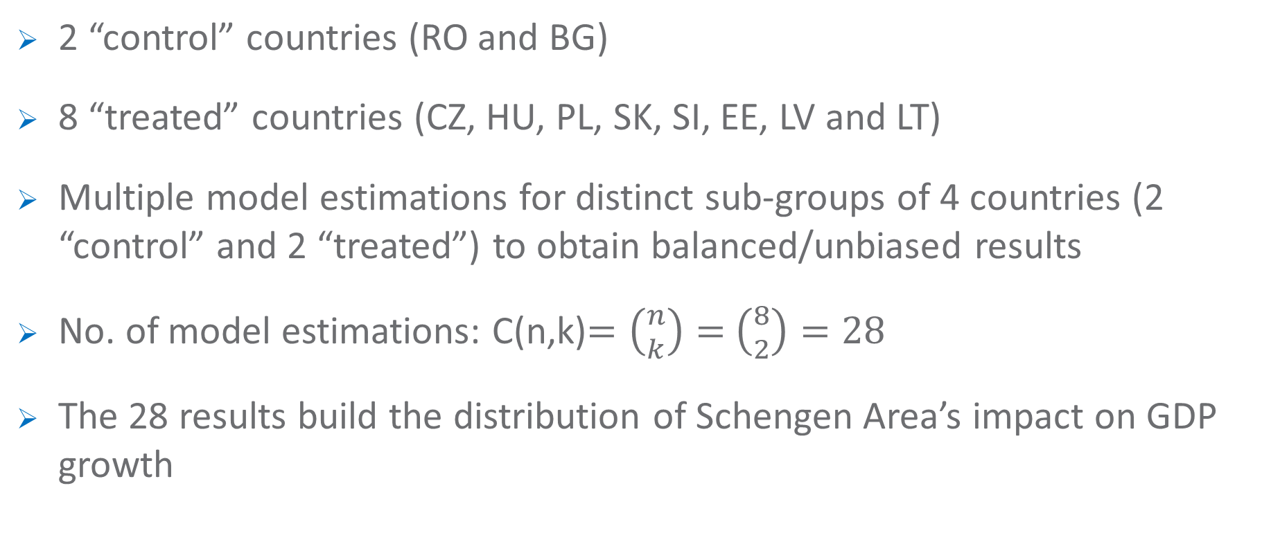
7. Model (cont.)
2 “control” countries (RO and BG)
8 “treated” countries (CZ, HU, PL, SK, SI, EE, LV and LT)
Multiple model estimations for distinct sub-groups of 4 countries (2 “control” and 2 “treated”) to obtain balanced/unbiased results
No. of model estimations: C(n,k)$=\left({n \atop k}\right)=$ $\left({8 \atop 2}\right)=28$
The 28 results build the distribution of Schengen Area’s impact on GDP growth

Slide 12
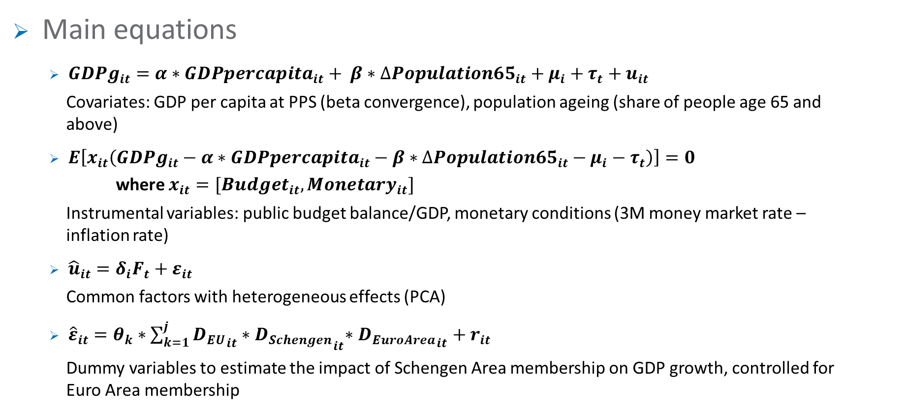
7. Model (cont.)
Main equations
  ${GDPg}_{it}=α∗{GDPpercapita}_{it}+ {β∗∆Population65}_{it}+μ_{i}+τ_{t}+u_{it}$
  Covariates: GDP per capita at PPS (beta convergence), population ageing (share of people age 65 and
  above)
  $E\left[x_{it}\left({GDPg}_{it}−α∗{GDPpercapita}_{it}−{{β∗∆Population65}_{it}−μ}_{i}−τ_{t}\right)\right]=0$
  where $x_{it}=[{Budget}_{it}, {Monetary}_{it}]$
  Instrumental variables: public budget balance/GDP, monetary conditions (3M money market rate –
  inflation rate)
  ${\hat{u}}_{it}=δ_{i}F_{t}+ε_{it}$
  Common factors with heterogeneous effects (PCA)
  ${\hat{ε}}_{it}=θ_{k}{∗\sum_{k=1}^{j}{{D_{EU}}_{it}}∗D_{Schengen}}_{it}∗{D_{EuroArea}}_{it}+r_{it}$
  Dummy variables to estimate the impact of Schengen Area membership on GDP growth, controlled for
  Euro Area membership

Slide 13
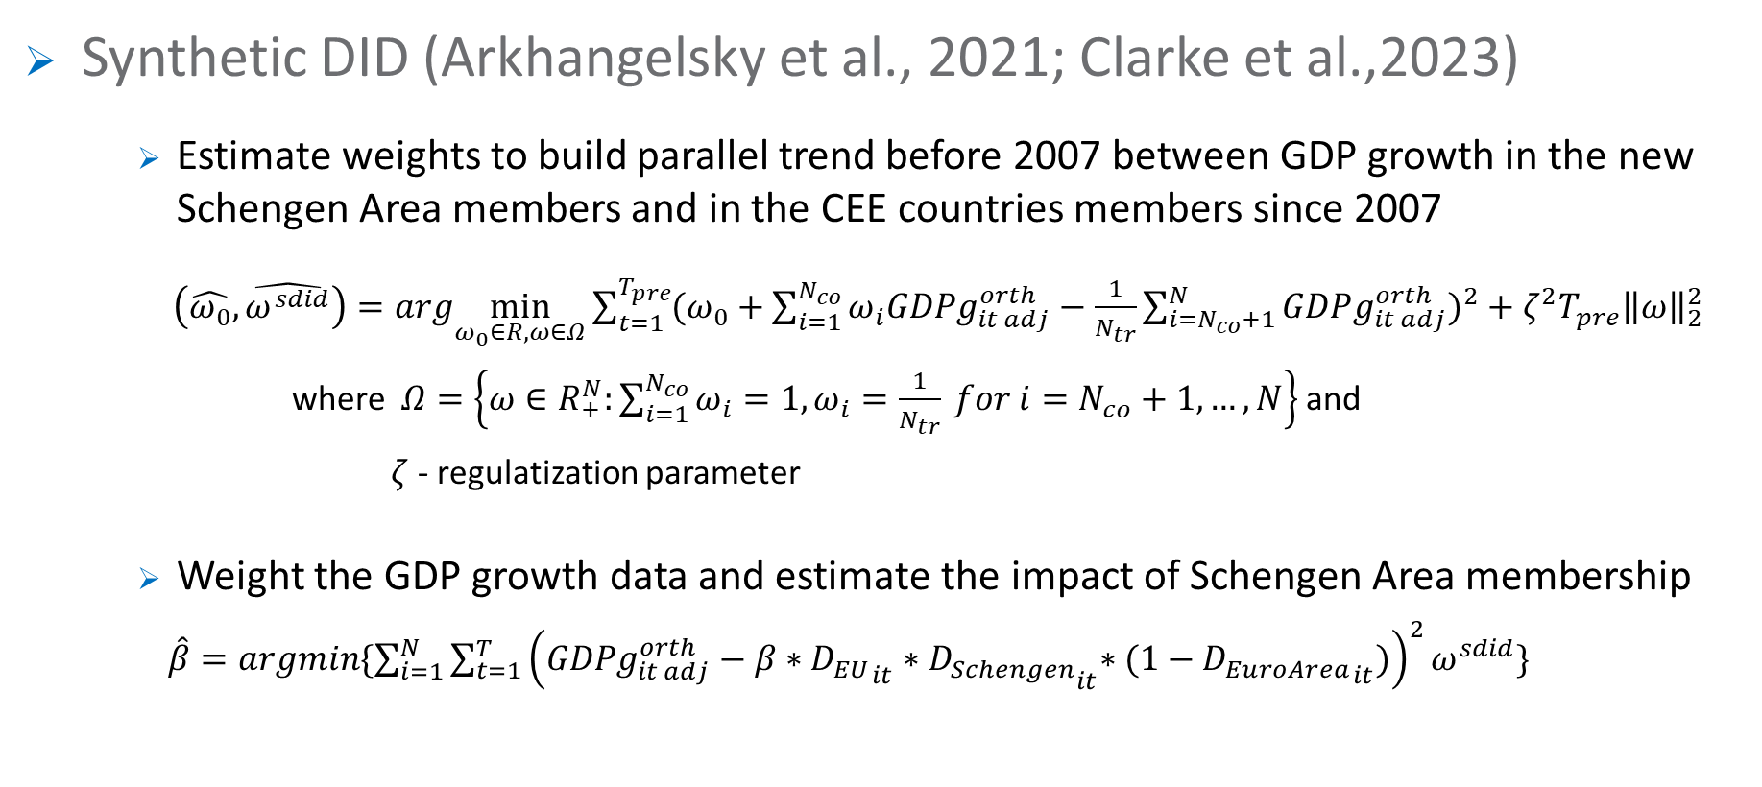
7. Model (cont.)
Synthetic DID (Arkhangelsky et al., 2021; Clarke et al.,2023)
      Estimate weights to build parallel trend before 2007 between GDP growth in the new Schengen Area members and in the CEE countries members since 2007
$\left(\hat{ω_{0}},\hat{ω^{sdid}}\right)=arg\min_{ω_{0}∈R,ω∈Ω}{\sum_{t=1}^{T_{pre}}{{(ω_{0}+\sum_{i=1}^{N_{co}}{ω_{i}{GDPg}_{it adj}^{orth}}−\frac{1}{N_{tr}}\sum_{i=N_{co}+1}^{N}{{GDPg}_{it adj}^{orth}})}^{2}}+ζ^{2}T_{pre}{\left\|ω\right\|}_{2}^{2}}$
where $Ω=\left\{ω∈R_{+}^{N}:\sum_{i=1}^{N_{co}}{ω_{i}=1,ω_{i}=\frac{1}{N_{tr}} for i=N_{co}+1,…, N}\right\}$ and
    $ζ$ - regulatization parameter
      Weight the GDP growth data and estimate the impact of Schengen Area membership
$\hat{β}=\operatorname{argmin}{\{\sum_{i=1}^{N}{\sum_{t=1}^{T}{{\left({GDPg}_{it adj}^{orth}−β{∗{D_{EU}}_{it}∗D_{Schengen}}_{it}∗(1−{D_{EuroArea}}_{it})\right)}^{2}}}ω^{sdid}\}}$

Slide 14
7. Model (cont.)
The model compares GDP growth in the CEE countries, before and after joining the Schengen Area, controlled for other growth determinants
The parallel trend assumption creates counterfactual scenario for “treated” countries (if they hadn’t acceded to the Schengen Area)
The effect of Schengen Area membership represents the deviation of GDP growth in the “treated” countries from the constructed parallel trend in the “control” countries
This is not a forecasting model; the model assumes that the estimated additional GDP growth in the CEE countries that joined the Schengen Area in 2007 will occur in the new Schengen Area members as well

Slide 15
8. Results
Impact of Schengen Area membership on GDP growth in the CEE countries (annualized data)
Schengen Area membership added, on average, 0.24 percent to the real GDP growth each year in the CEE countries, controlled for euro currency adoption
The benefits can be even larger if CEE countries improve their integration in the European value chains and develop adequate infrastructure
During economic turmoil, participating in the Schengen Area enhances resilience and supports economic recovery
Source: Authors’ calculations.

Slide 16
8. Results (cont.)
Although the methodology controls for country heterogeneity, the estimated impact of Schengen Area membership on GDP growth exhibits certain variation, between -0.04% and 0.48% annually
The estimated interval of additional GDP growth could be explained by the different dates when CEE countries adopted the euro currency
Controlling the results for Euro Area membership determined variation in the number of CEE countries considered for each period
The CEE countries may experience higher growth rates than the median estimated impact if they succeed to deepen their EU integration and to scale up trade

Slide 17
8. Results (cont.)
Impact of Schengen Area membership on GDP growth in the CEE countries (annualized data)
On average, the global financial crisis and the euro debt crisis (2009-2010) were more costly for the CEE countries outside the Schengen Area, in terms of GDP growth
The mobility restrictions imposed during pandemic temporarily cancelled almost all the benefits of Schengen Area membership
The onset of the war in Ukraine triggered a severe inflationary shock in the region, which was only marginally mitigated by the Schengen Area’s cost efficiencies
Source: Authors’ calculations.

Slide 18
9. Further integration of the Single Market
Enrico Letta (2024), Much more than a market
  Important legal and administrative cross-border obstacles remain in the Single Market and Schengen Area; the barriers hamper people living in border regions to find jobs or provide services in neighbouring regions
IMF (2024), Regional Economic Outlook – Europe
  As of 2020, the trade barriers and the barriers to enter markets within the EU were equivalent to 44% tariffs on manufacturing sector (compared with 15% in US) and to 110% tariffs on services sectors
  Emerging European countries reduced the pace of reforms post-2004 EU accession, affecting convergence
  European regions better integrated through value chains and transport networks benefited more form trade

Slide 19
10. Conclusions
Acceding to the Schengen Area at a later stage, CEE countries are net beneficiaries; according to our estimates, GDP growth rate increased on average by 0.24% each year
The absence of border checks facilitates mobility, encourages trade and investments, stimulates competition and reduces costs
Participating in the European value chains is even more valuable nowadays, in a global context marked by trade frictions
The removal of remaining internal barriers will deepen integration in the Schengen Area

Slide 20
References
Angrist, J. and Pischke, J.S. (2009). Mostly harmless econometrics: an empiricist's companion, Princeton University Press.
Arkhangelsky, D., Athey, S., Hirshberg, D.A., Imbens, G.W. and Wager, S. (2021). Synthetic Difference in Differences, arXiv:1812.09970v4.
Aussilloux, V. and Le Hir, B. (2016). The Economic Cost of Rolling Back Schengen. Paris: France Stratégie.
Bai, J. (2009). Panel data models with interactive fixed effects. Econometrica, vol. 77, No. 4 (July 2009), 1229-1279.
Bai, J. and Ng, S. (2017). Principal components and regularized estimation of factor models. arXiv:1708.08137v2.
Böhmer, M., Limbers, J., Pivac, A. and Weinelt, H. (2016). Departure from the Schengen Agreement. Macroeconomic impacts on Germany and the countries of the European Union. Bertelsmann Stiftung.
Clarke, D., Pailanir, D., Athey, S. and Imbens, G.W. (2023). Synthetic Difference-in-Differences Estimation. IZA Discussion Paper No. 15907.

Slide 21
References (cont.)
Davis, D. and Gift, T. (2014). The Positive Effects of the Schengen Agreement on European Trade. The World Economy, 1-17.
European Commission. (2016). Back to Schengen - A Roadmap.
European Parliament. (2016a). The economic impact of suspending Schengen. March
European Parliament. (2016b). Cost of non-Schengen: the impact of border controls within Schengen and the Single Market. May. 10.2861/932617.
Felbermayr, G., Groschl, J. and Steinwachs, T. (2017). The Trade Effects of Border Controls: Evidence from the European Schengen Agreement. Journal of Common Market Studies, 1-17. 10.1111/jcms.12603.
IMF. (2024). Regional Economic Outlook – Europe, October 2024, International Monetary Fund.
Letta, E. (2024). Much more than a market.
Parenti, A. and Tealdi, C. (2019). Does the Implementation of the Schengen Agreement Boost Cross-Border Commuting? Evidence from Switzerland. IZA.

Slide 22

Thank you!

