Slide 1

Artificial Intelligence and the Labor Market by M. Hampole, D. Papanikolaou, L. D.W. Schmidt and B. Seegmiller
Discussion by
Ana Lamo
ECB-DG-Research
8TH ANNUAL RESEARCH CONFERENCE
ECONOMICS OF ARTIFICIAL INTELLIGENCE
Banco de España, 13 & 14 Nov. 2025

Slide 2
This paper
The paper investigates how advances in artificial intelligence (AI) affect labour demand across tasks, occupations, and firms- distinguishing between substitution and reallocation; for US between 2010 and 2023.

Slide 3
Findings
Task-level
Tasks with higher AI exposure see reduced labour demand, reflecting substitution away from human labour.
Occupation level
Mean exposure of an occupation’s tasks → depresses labour demand.
Concentration of exposure in a few tasks → allows reallocation, offsetting some negative effects.
Notes:
.

Slide 4
Findings cont.
Firm-level
At adopting firms, productivity gains from AI can increase overall labour demand, counterbalancing substitution losses.
Aggregate labour market effects:
Despite strong substitution at the task level, the overall employment impact is modest.
Notes:
.

Slide 5
Task exposure literature
AI-applications
Patents descriptions: Webb (‘20), Hotte et al (‘24)
Advances AI applications (EFF): Felten et al(’20)
Resumes from Revelio Labs (2014–2023 ) Hampole et al (‘25)
Tasks description
(ONet, ESCO)
-> Textual analysis
-> Subjective (mTurk survey)
-> NLP
AI Task exposure

Slide 6
Task exposure literature (Hampole et al, 2025)
AI Task exposure
(actual)
Distribution:
mean and concentration
Labour demand
Occupation
(Babina et al ‘23)
Firms
Notes:
Actual ; bridges the gap between potential exposure and realized adoption ➔ actual exposute

Slide 7
Rest of the discussion
1. Novel Measurement of AI applications
2. NLP-based task exposure
3. Theoretical Framework: Substitution vs. Reallocation
4. Empirical Evidence with Causal Identification
Some general suggestions
Notes:
.

Slide 8
1. Novel Measurement of AI applications
Resumes of AI developers to extract what AI applications they develop for their firm. Source: Revelio Labs (2014–2023 )
AI applications developed in the firm: AI adoption → actual AI Taks exposure
Time dimension: Tracks changes in exposure across more than a decade of AI diffusion
Notes:
.

Slide 9
1. Novel Measurement of AI applications
Some remaining limitations
Coverage: Unequal representation of resumes across sectors.
>> normalise by industry
Off-the-self AI applications are not considered. Vendor adoption might be missing. Latest AI tool might also be overlooked at.
Notes:
.

Slide 10
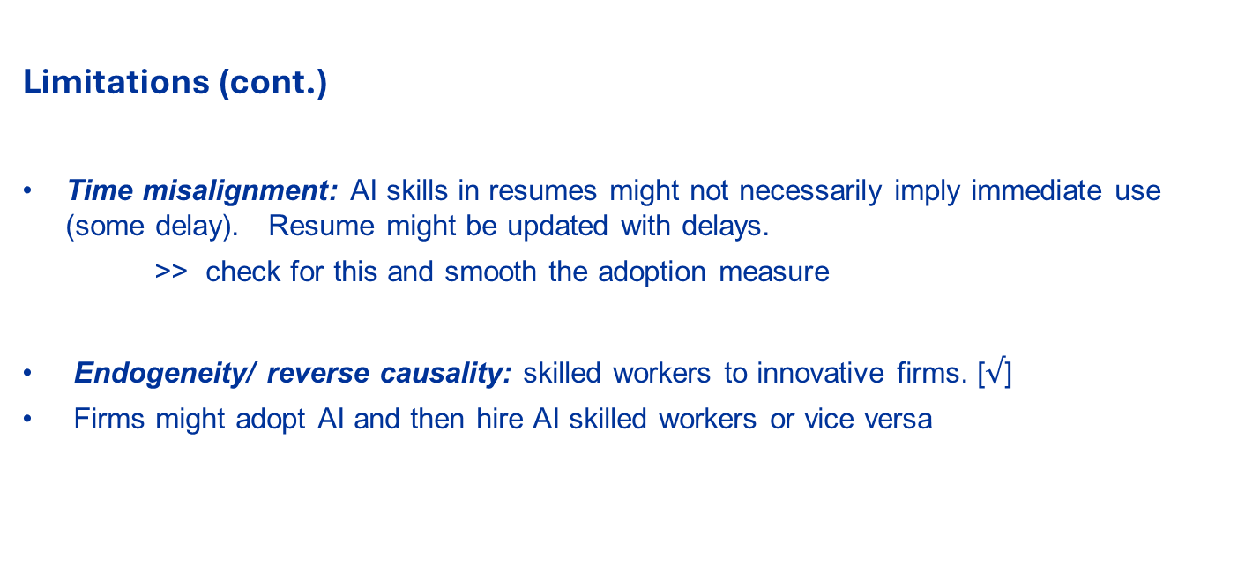
1. Novel Measurement of AI applications
Limitations (cont.)
Time misalignment: AI skills in resumes might not necessarily imply immediate use (some delay). Resume might be updated with delays.
>> check for this and smooth the adoption measure
Endogeneity/ reverse causality: skilled workers to innovative firms. [$√$]
Firms might adopt AI and then hire AI skilled workers or vice versa
Notes:
.

Slide 11
2. NLP-based task exposure
Develops new task-level measures of AI exposure (2010–2023) using natural language processing (NLP) to compute the semantic similarity between AI applications and task descriptions.
Improves on prior work by offering:
Granularity: Goes beyond occupation-level to analyze variation within jobs and across firms.
Time dimension: Tracks changes in exposure across more than a decade of AI diffusion.
Actual vs potential exposure
Notes:
.

Slide 12
2. NLP-based task exposure
Some remaining limitations
NLP can overstate or understate true exposure, because:
NLP exposure scores capture semantic association, which not always imply technological suitability..
How well captures frontier capabilities will depend on the NLP training period
Might generate clusters of artificial intelligence exposure – tasks are described with short and generic text (record, analyse, review, data …)
Task descriptions: Overrepresentation of professional occupations, younger cohorts, and digitally engaged workers.

Slide 13
3. Theoretical Framework: Substitution vs. Reallocation
Introduces a model that separates two channels of AI’s labour market impact:
Direct substitution: AI replaces human tasks → depresses demand.
Indirect reallocative effects: Workers shift effort from exposed to less-exposed tasks → offsets displacement.
Identifies two key variables for labour demand outcomes within firms:
Mean exposure (higher → more negative).
Concentration of exposure (higher → reallocation possible, less negative).
Notes:
.
Previous literature focused mostly on levels of exposure (“how much” AI affects a job).
This paper shows that the structure of that exposure (“how exposure is distributed across tasks”) can mitigate or amplify AI’s employment effects.
In other words:
Not just how exposed a job is, but how exposure is organized across its tasks determines how AI affects labor demand.

Slide 14
3. Theoretical framework. A suggestion
Model frictions in reallocation. training/retraining costs, skill transferability, or managerial constraints. This would make the “reallocation” mechanism more realistic.

Slide 15
4. Empirical Evidence with Causal Identification
This paper goes beyond descriptive correlations by addressing endogeneity — i.e., firms that adopt AI may differ systematically from others.
Exogenous exposure to Ai research thought historical university hiring networks as an (shift share) instrumental variable to establish causality in AI adoption/exposure and labour demand effects.
Notes:
.

Slide 16
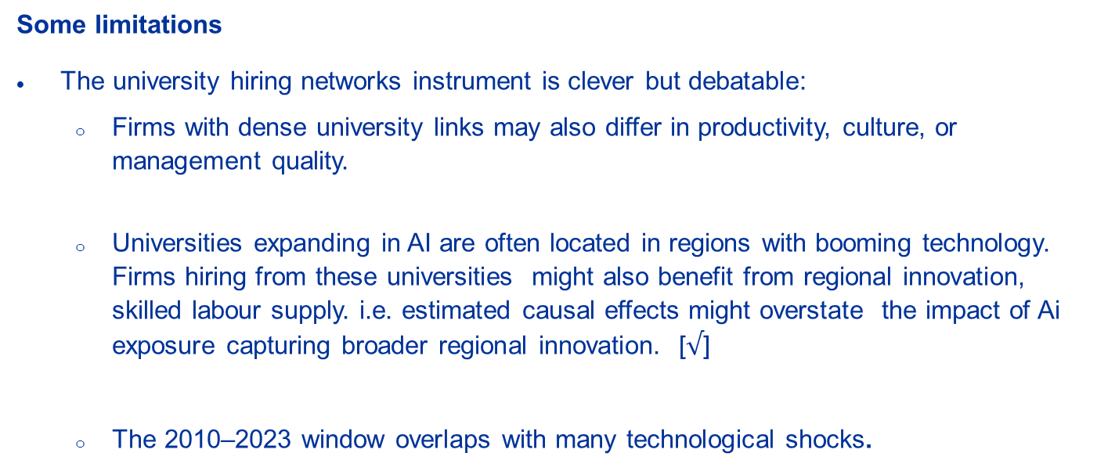
4. Empirical Evidence with Causal Identification
Some limitations
The university hiring networks instrument is clever but debatable:
Firms with dense university links may also differ in productivity, culture, or management quality.
Universities expanding in AI are often located in regions with booming technology. Firms hiring from these universities might also benefit from regional innovation, skilled labour supply. i.e. estimated causal effects might overstate the impact of Ai exposure capturing broader regional innovation. [$√$]
The 2010–2023 window overlaps with many technological shocks.

Slide 17
4. Empirical Evidence with Causal Identification
An infrastructure instrument: AI Data Centre/Cloud Compute Access
Idea: staggered rollout of AI-optimized cloud infrastructure (e.g., AWS, Azure, Google Cloud regions) as a source of variation in firms’ access to AI capabilities.
Intuition: Firms closer to newly opened AI compute hubs face lower cost barriers to using machine learning or generative AI APIs.
Exclusion argument: The rollout of AI-optimized centres (TPU, H100 clusters) affects AI feasibility, not general innovation.
Data sources: Public release logs from AWS, Azure, GCP on region openings. Firm HQ locations.

Slide 18
Suggestions for extensions
Distributional effect: Age/gender/etc. (Albanesi et al (2024, 2025))
Discuss possible nonlinearities as AI systems mature.
Post 2023

Slide 19
The question
Do you expect the same substitution–reallocation balance to hold post-2023?
Notes:
How might results evolve as AI moves into more cognitive and creative domains ?

Slide 20

Very interesting and very well executed paper with relevant contributions

Slide 21

Thanks

