Slide 1

MACROECONOMIC AND FINANCIAL ASPECTS OF CLIMATE CHANGE JOSÉ LUIS ESCRIVÁ BANCO DE ESPAÑA GOVERNOR 14.11.2024
7TH BANCO DE ESPAÑA ANNUAL RESEARCH CONFERENCE

Slide 2
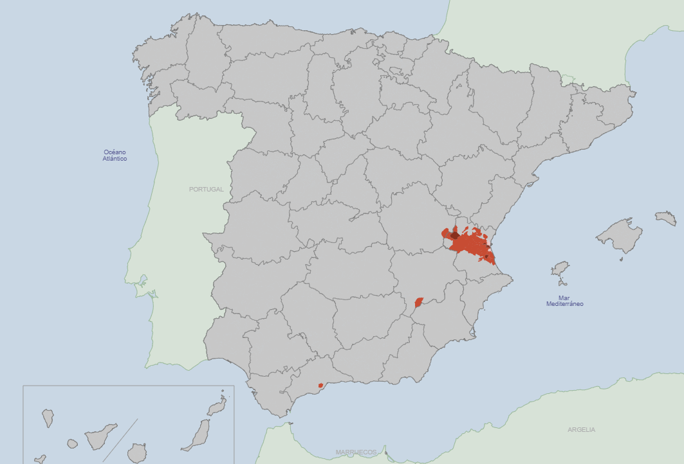
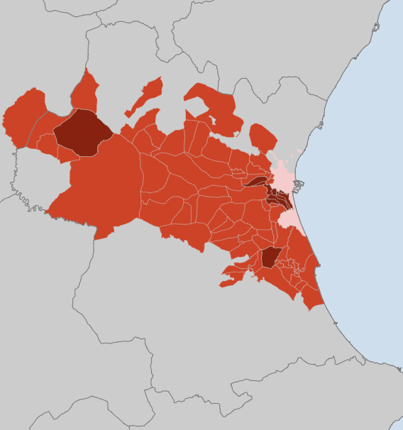
Areas affected by the DANA
municipalities affected by The dana, according to RDL 6/2024*
Municipality of Valencia
78 municipalities included in the government’s aid package
13 municipalities more severely affected
* In the municipality of Valencia (in pink), affected areas are “pedanías del sur”, with around 21.000 inhabitants.

Slide 3
Economic relevance of the areas affected by the DANA
WEIGHT OF AFFECTED AREAS IN THE PROVINCE OF VALENCIA OVER TOTAL IN SPAIN
TOTAL ECONOMY
INDUSTRY
INFRASTRUCTURES
(based on flooded areas)
%
%
%
Average: 3
Source: INE, Banco de España, Catastro, Copernicus EM, DIRCE.

Slide 4
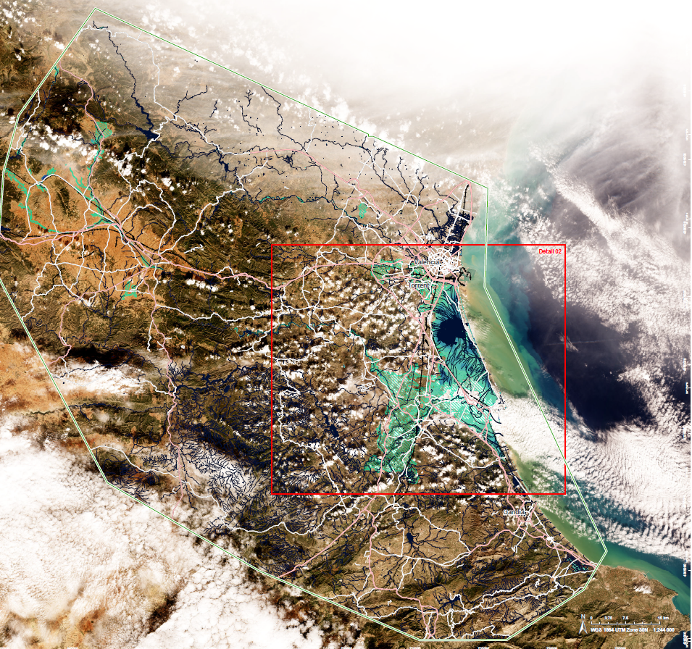
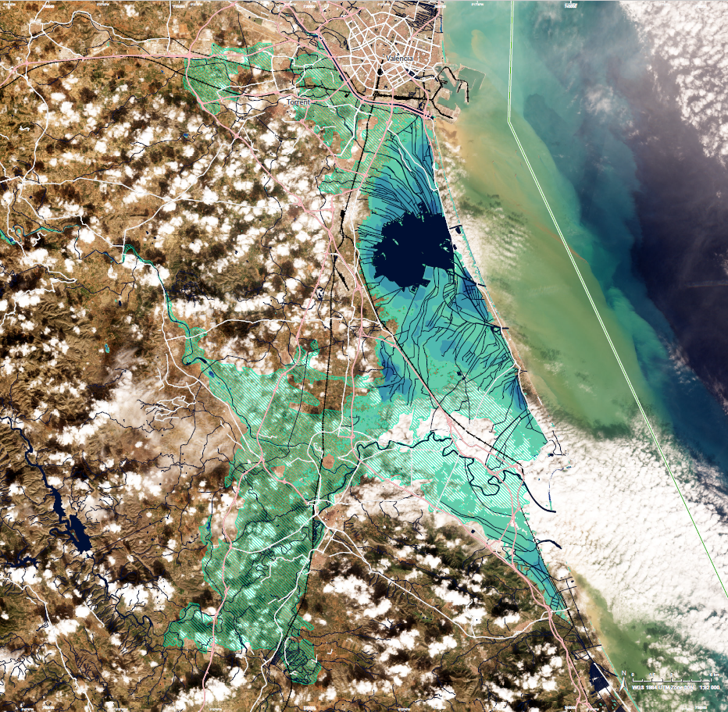
Areas affected by the DANA
Copernicus EMS Rapid Mapping https://rapidmapping.emergency.copernicus.eu/EMSR773/download

Slide 5
Real-time monitoring of the economic impact: bottlenecks
Source: Banco de España. Burriel, Kataryniuk, Moreno-Pérez and Viani (2024). 15-day moving average. Last observation: 12 November 2024.

Slide 6
b
Historical international evidence points to a negative short-run impact of nature-related events on GDP
The impact of the DANA on Spain’s GDP growth is uncertain and will depend on various factors, such as the percentage of economic activity affected and the magnitude and timeliness of fiscal measures implemented
ESTIMATED IMPACT OF NATURE-RELATED EVENTS ON GDP
CURRENT QUARTER
ONE YEAR AFTER
Source: Own calculations based on Eurostat and EM-DATA. The EM-DATA database collects natural disasters in Europe in the last 23 years, including drought, earthquake, epidemic, flood, glacial lake outburst, flood, infestation, mass movement, storm, volcanic activity, wildfire. Extreme temperature events are excluded (e.g. Spain heat wave in 2022 with 11,000 casualties).

Slide 7




The fiscal response to the DANA
On November 5th and 11th, the Government enacted fiscal measures to support households, firms, and other public administrations (reestablishing local insfrastructure).
HOUSEHOLDS
Including assistance to compensate for property damage
FIRMS & SELF-EMPLOYED
Including direct transfers (about EUR 1bn)
PUBLIC INFRASTRUCTURE
Including street cleaning and water infraestructure
FINANCIAL AID
Including public guarantees to households, firms and self-employed (about EUR 5bn) and moratoria

Slide 8
Distribution and access to cash: monitoring cash lodgements and payments
Lodgements are expected to grow this week once the procedure to exchange damaged banknotes is in place
Payments last week nearly doubled the amount of the previous year to ensure the capacity to provide non-damaged banknotes

Slide 9


Impact on payments
11% of Point of Sale terminals in the area have not operated since 29 October.
Sales using Point of Sale terminals have fallen by 15% in the area
Volume of Cash withdraws in ATMs has declined by 5%
Source: Redsys

Slide 10
Impact on the banking system: Macroprudential picture
VOLUME OF EXPOSURE IN AFFECTED AREAS
(% outstanding households or NFCs loans)
NUMBER OF AFFECTED HOLDERS
(% total households or NFCs holders)

Slide 11
Impact on the banking system: Operational capacity
280
Branches in the affected area
44
Non-operative branches as of today
Percentage of total branches in the affected areas
23%
22%
19%
18%
16%
Source: Daily survey to entities

Slide 12
Impact on the banking system: Measures adopted
Loan moratoria
Insurance Claims (Insurance Compensation Consortium + direct claims)
Source: Daily survey to entities

Slide 13
Impact on the banking system: Microprudential picture
DISTRIBUTION OF EXPOSURES in affected area
(million €)

Slide 14

THANK YOU

