Slide 1
HOW BANCO DE ESPAÑA IS ADDRESSING THE ENVIRONMENTAL SUSTAINABILITY OF CASH
Carlos González Constán
Head of the Production Control Division
THE FUTURE OF CASH
Madrid
14-16 September 2022
Banknote Production Control Department

Slide 2
INDEX
Introduction
Banco de España cash and environmental context
International context
National context
Analysis of Banco de España environmental actions in the cash cycle
Design
Production
Distribution
End of life
R+D
Summary
Banknote production control department

Slide 3
I. Introduction
National Central Banks functions:
Defining and implementing the monetary policy
Promoting the proper working and stability of the financial system
Supervising solvency and compliance of credit institutions
Promoting the proper working of payment systems
Issuing legal tender banknotes and coins
Providing treasury services
Conducting economic analysis and research
Advising the Government
Banknote production control department

Slide 4
I. Introduction
All Banco de España´s activities have an environmental perspective:
Financial stability, monetary and supervision policies have a paramount impact in the mitigation of the environmental risk of the economies and in the financial sector participants
NCBs are working on these areas to be able to manage or to mitigate the impact of the environmental risks
BdE is also an organization with its own environmental footprint that has to be improved:
Management of its non-monetary investment portfolio
Improvement of buildings and internal procedures
Banknote production control department

Slide 5
I. Introduction
Cash activity is the only core activity conducted by the NCB that could be considered as an industrial one, and so, with a clear environmental impact that has to be managed
Banknote production control department

Slide 6
II. 1. international context
Banco de España has to comply with international guidelines
The Euro is the common currency of the Eurosystem (19 countries share the same currency)
As member of the Eurosystem, Banco de España is co-responsible in the design, production, distribution and circulation of euro banknotes
Banco de España is bounded by the Eurosystem regulation regarding banknotes (Guidelines, Decisions and Agreements), covering also environmental issues
Banco de España is bounded by the EC regulation regarding euro coins.
Banco de España has to comply with the European regulation on sustainability
EU Directives once they are transposed into a national law
EU Decisions, Regulations and Guidelines, immediately
Banknote production control department

Slide 7
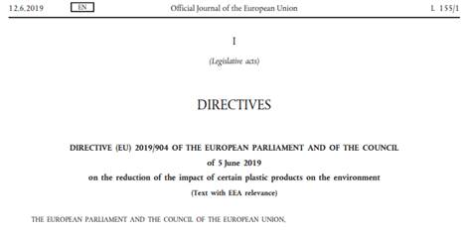
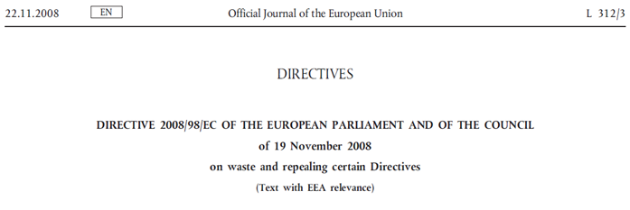
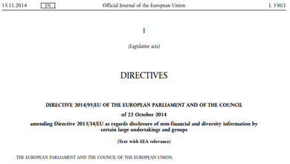
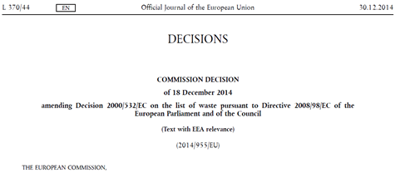
II. 1. international context
Banco de España has to comply with international guidelines
Banknote production control department

Slide 8
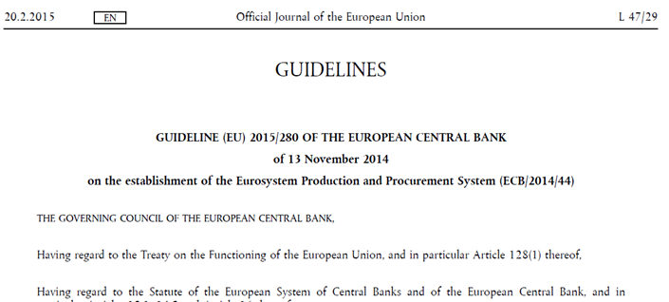
II. 1. international context
There is a common framework for the euro banknotes, but not identical among countries:
Two different production approaches
Production in In-house printing works
Procurement to independent printing works
19 different cash cycles regarding issuance and circulation
Common frameworks and general rules
Flexibility to take into account national rules, requirements and peculiarities of professionals and public
Eurosystem cash strategy regarding cash environmental sustainability
Banknote production control department

Slide 9
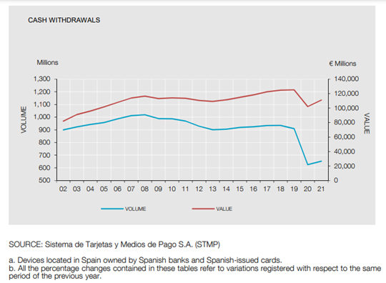
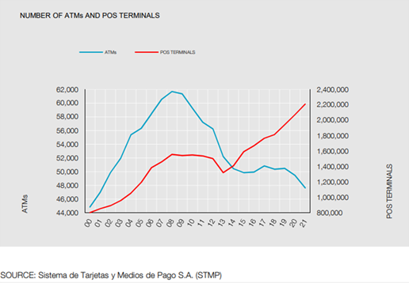
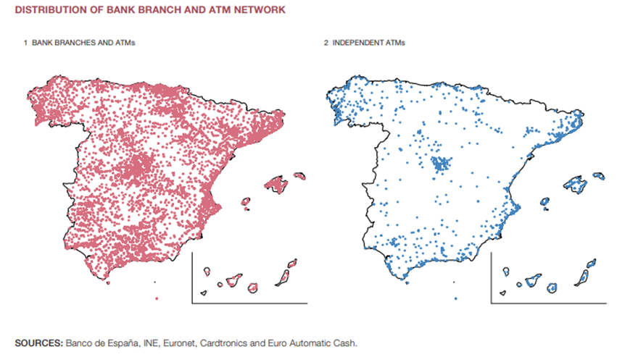
II. 2. National context
Specific features of the national cash cycle
Cash demand
Distribution channels
Technical peculiarities
Geographical peculiarities
Source: BdE Bank payment cards statistics https://www.bde.es/f/webbde/SPA/sispago/ficheros/en/estadisticas_ingles.pdf
Source: Cash infrastructure and cash Access vulnerability in Spain. Author: Diana Posada Restrepo. Analytical Articles. Economic Bulletin 3/2021. Banco de España.
Banknote production control department

Slide 10
II. 2. National context
Specific features of the national cash cycle
Banknote production control department

Slide 11
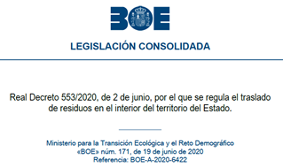
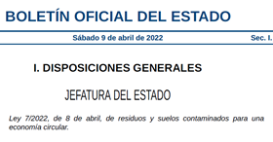
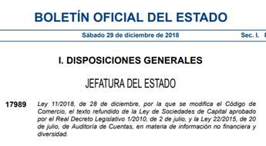
II. 2. National context
National regulation on cash and on sustainability
Incorporation of the Spanish in-house separate PWs IMBISA
Construction of IMBISA new premises
Banknote production control department
Notes:
2.

Slide 12
II. 2. National context
BdE Strategic Plan 2024 (Environmental Sustainability)
Context analysis: “A new area to be taken into account is the growing social demand for environmental sustainability and social responsibility to be put on the public agenda. This is expected to lead to regulatory developments that affect the Banco de España and financial institutions, in terms of identifying and managing the new risks in this field.”
Plan 5.6. Promotion of sustainability and social responsibility at the Banco de España
“adopting an active role in social and environmental matters”
(...)
Banknote production control department

Slide 13
II. 2. National context
BdE Strategic Plan 2024 (Environmental Sustainability)
(...)
Definition of the Corporate sustainability policy
Creation of a special cross-cutting service for planning and coordinating environmental actions.
Implementation of an environmental management system.
Analysis of the OEF
Environmental management in respect of cash
Research collaboration projects
Banknote production control department

Slide 14
III. Analysis of BdE environmental actions in the cash cycle
There is not one-size-fits-all solution or best strategy for improving the cash environmental footprint.
The production structure, the cash-cycle, the public habits, … have a very important impact on it. But in all cases, the NCBs have the responsibility and the opportunity to steer actions in order to improve the environmental footprint of cash.
A clear National Central Bank strategy is needed to reduce the environmental footprint of cash.
Main points of the strategy:
Definition
Communication
Resources
Global (cradle to grave approach)
Design
Production
Distribution
End of life
R+D
Banknote production control department

Slide 15
III. Analysis of BdE environmental actions in the cash cycle
Eco-Design
BdE actions on design are conducted as member of the Eurosystem
Definition of the banknote family and banknote features
Main points:
Raw materials and processes
Extent durability
Consider not only production: distribution (packaging) and end of life (recycling).
Banknote production control department

Slide 16
III. Analysis of BdE environmental actions in the cash cycle
Production
General production framework and rules defined by the Eurosystem
All manufacturer must be accredited according to the public ECB Decision on Accreditation ECB/2020/24. In this decision it is clearly stated that “all companies involved in the production process must be in full compliance with the ISO 14001 international standard (Environmental Management Systems – Requirements and guidance for use)” (see ECB webpage).
100% sustainable cotton for the production of banknote paper.
Control of consumptions, emissions and waste levels during production
BdE production decisions
Incorporation of IMBISA and construction of the new plant
Banknote production control department

Slide 17
III. Analysis of BdE environmental actions in the cash cycle
Distribution
Minimum quality standards for the recirculation of fit banknotes stablished by the Eurosystem
Cross border rules defined by the Eurosystem
National distribution defined by NCBs.
Main environmental points:
To minimize the number of transports
Network of “self-sufficient” sorting centers in the NCB branches with capacity to sort all their deposits and to shred all the unfit banknotes locally.
Local sorting Local shredding Local waste management
To collaborate with private institutions to streamline the distribution
To use more sustainable trucks, taking into consideration the potential local limitations for refueling and driving range.
To request international standards to the institutions that participate in the banknote distribution (CI, CIT, cargo flights,….)
Banknote production control department

Slide 18
III. Analysis of BdE environmental actions in the cash cycle
End of life
General rules defined by the Eurosystem
Production waste
Shredded banknote waste
National regulation for waste management
Transposition of EU Directive 2008/98/CE on waste
Law 7/2022 on waste
Royal Decree 553/2020 on waste transport
Decentralized regulation model
Competences delegated to the Autonomous Communities and to the City Councils
(...)
Banknote production control department

Slide 19
III. Analysis of BdE environmental actions in the cash cycle
End of life
(...)
BdE policy for banknote waste management
To have a decentralised network of banknote shredding centers
To ban the use of landfill or combustion (no energy recovery)
To prioritize the recycling of shredded banknotes
To foster local solutions for the disposal of shredded banknotes whenever possible (avoid additional transport impact).
To push new recycling solutions for the shredded banknotes
To segregate and manage in the most efficient way the side waste from banknote sorting
Banknote production control department

Slide 20
III. Analysis of BdE environmental actions in the cash cycle
R+D
Cross-cutting activity as there is room for improvement in all the phases of the Cash Cycle
BdE collaborates with the R+D environmental projects of the Eurosystem
BdE fosters additional local environmental projects
Banknote production control department

Slide 21
IV. Summary
Total commitment of the Banco de España with the environmental sustainability
BdE decisions for cash environmental improvements must be coordinated and aligned with:
Eurosystem Cash policy/rules
European Union Environmental policy/rules
Spanish regulators
BdE is working on improving the environmental footprint of cash in Spain
In a structured way (part of the BdE Strategic Plan 2024)
With a global perspective (from cradle to grave)
Financial stability
Investment portfolio
Cash issuer
Organization
Banknote production control department

Slide 22
Thank you for your attention carlos.gonzalez@bde.es
Banknote production control department

