Slide 1
Discussion of the Paper
“Monetary Normalizations and Consumer Credit: Evidence from Fed Liftoff and Online Lending” by Bertsch, Hull and Zhang
Maria Teresa Valderrama
Oesterreichische Nationalbank
1st Annual Workshop of the ESCB Research Cluster 1 on Monetary Economics,
Banco de España, Madrid, 9 and 10 October 2017

Slide 2
Summary
Effect of US monetary normalization on the P2P market
Kind of “sub-prime” market
Unique data set that allows identification of supply and demand
Results:
Effect of liftoff counterintuitive: supply of lending increases and therefore, instead of tightening financing conditions, interest rates go down and the spread between high and low risk borrowers narrows
Why?
Liftoff signals good news and for lenders this effect is stronger than an increase in their funding costs although there was no shift in the risk appetite of investors

Slide 3
Compliments
First of all, very good contribution to the literature!
Very well written
Excellent use of unique dataset
More than enough robustness tests to make a convincing point that the effect is supply driven

Slide 4
Comments
It is a bit controversial to argue there was “no shift in investor’s risk appetite”
Prosper reduced interest rates to meet increased supply of lending (interest rates are set ex-ante and are fixed)
In a second step, demand responded to better financing conditions
But, why do high risk borrowers benefit more than low risk borrowers?

Slide 5
Comments
If the signalling effect from liftoff is the main reason for an increase in supply, then supply should also react to other kind of news, which signal better macroeconomic conditions. This is not included in the robustness checks
I would argue, that the liftoff was not only a signal of the employment outlook and macroeconomic conditions but also a signal of future monetary policy stance (as also implied by the yield curve). In particular of future hikes in the interest rate.
Even if perceived default probabilities were falling, term risk and funding costs were also increasing.
Under this scenario a decrease in interest rates and in spreads, due to an increase in supply, without a shift in risk appetite is a bit counterintuitive

Slide 6
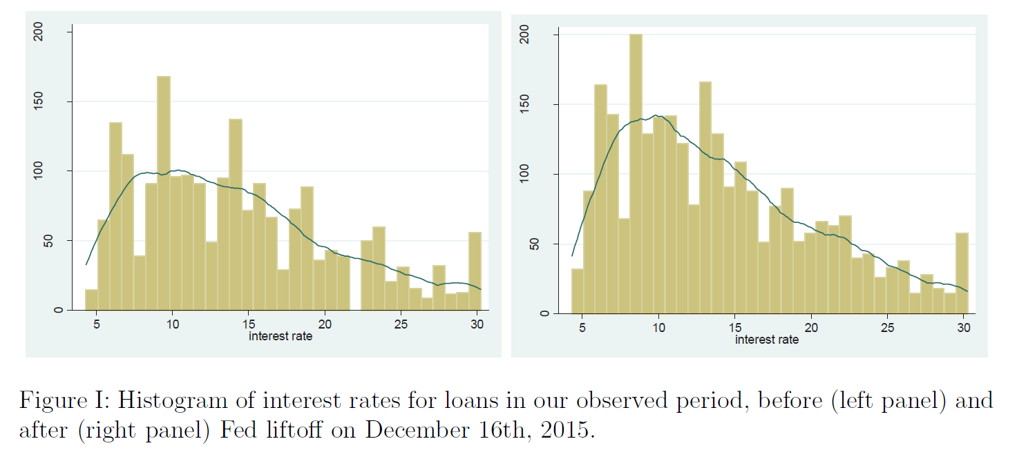

Slide 7
Policy implications, future research questions
Is this counterintuitive effect a result of the market (sub-prime) or of the “normalization” (being at the ZLB for so long)?
Repeat exercise for other FED interest rate increases
Answer important for transmission mechanism and financial stability

Slide 8
Thank you

