Slide 1
Central Banking: Past, Present and Future
By C.A.E. Goodhart
Financial Markets Group
London School of Economics

Slide 2
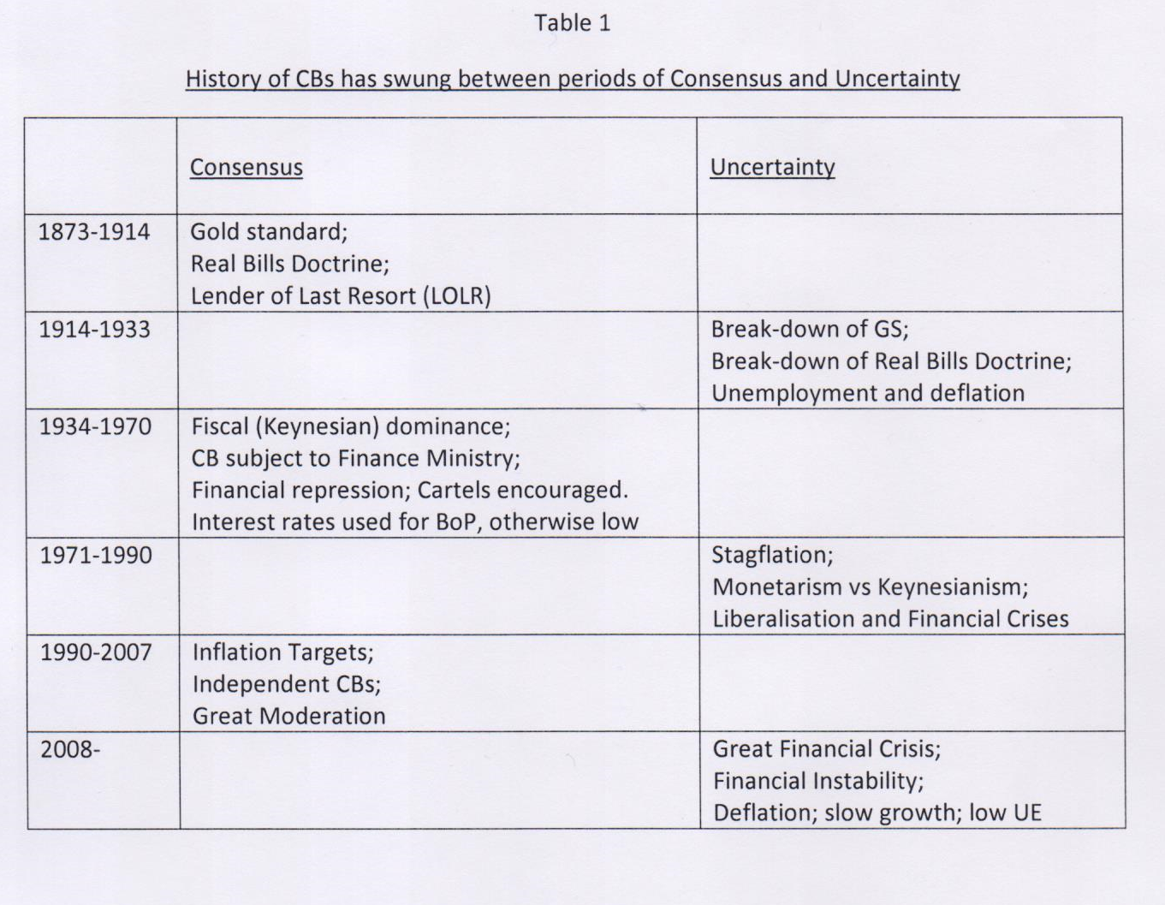

Slide 3
The Real Bills Doctrine
Cartels versus Competition
The NICE Years
Why the GFC?

Slide 4
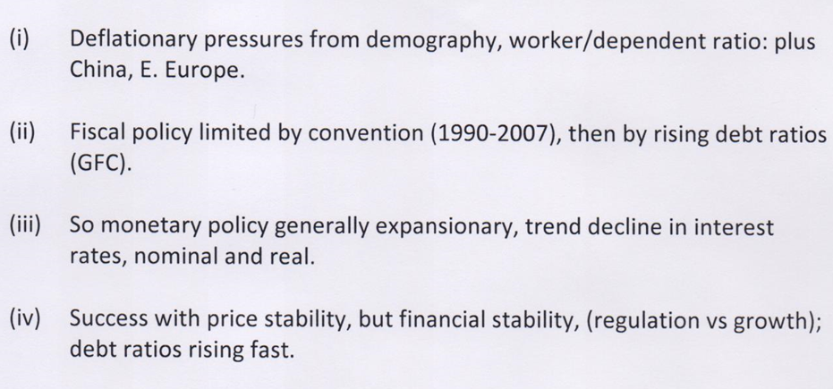
Table 2
1985 – 2007
Some Key Trends

Slide 5
Table 3
Generally Accepted Myths pre 2007
Price stability, plus Basel CARs, would guarantee solvency;
With solvency thus guaranteed, liquidity will always be available via wholesale markets;
That maturity mismatch in the banking system can be ignored.

Slide 6
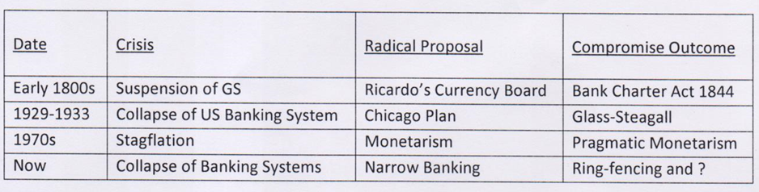
Table 4

Slide 7
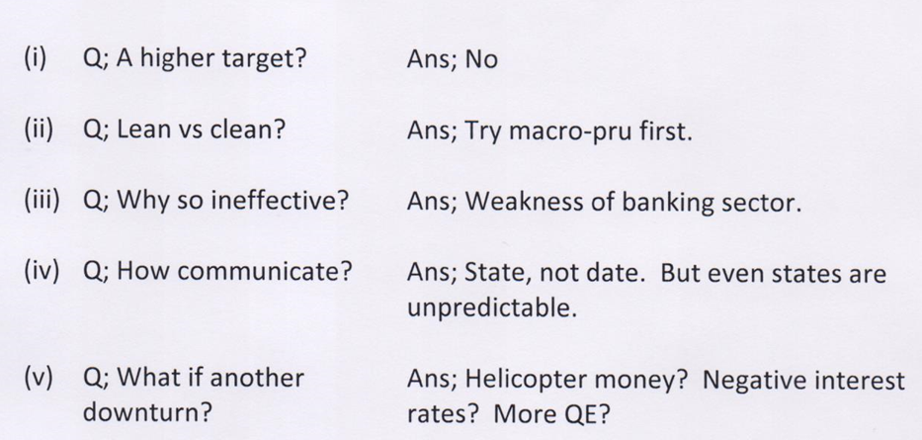
Table 5
Some Queries about Inflation Targetry

Slide 8
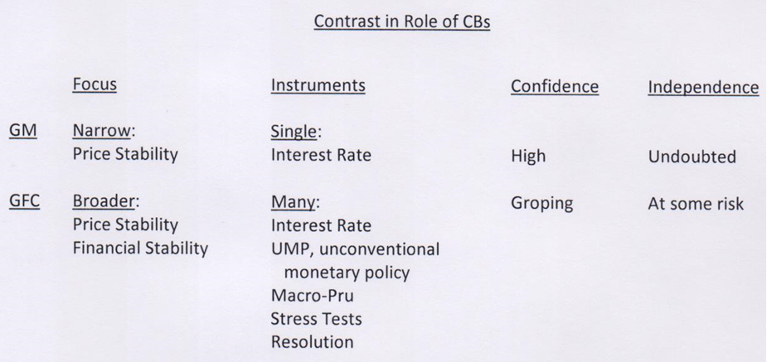
Table 6

Slide 9
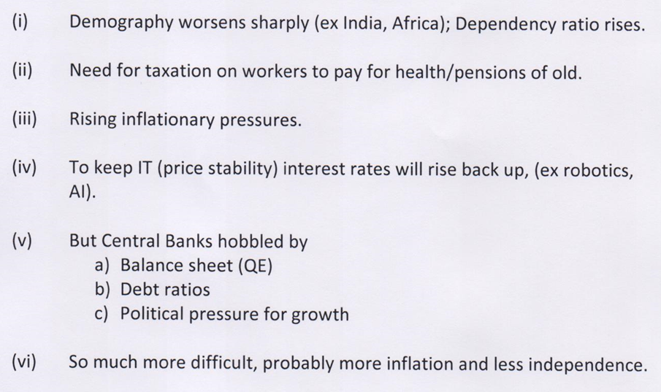
Table 7
Some Future Trends

Slide 10
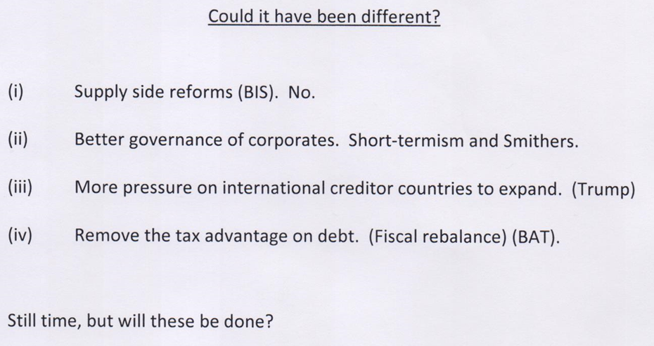
Table 8

Slide 11
Appendix I
Table A

Slide 12
Table B

Slide 13
Appendix 2
Some Queries about the use of Macro-Pru
Are they to protect the economy from banks, or banks from the economy? What is their main purpose?
Will they be used aggressively enough (Brainard caution)?
What is the dividing line between macro-pru and other policies, e.g. fiscal?
Since dividing lines are fuzzier, who controls?
How does one distinguish between sustainable and unsustainable financial developments, and how can one communicate that to both politicians and public, both of whom enjoy being in a boom period?

Slide 14
Appendix 2
Some Queries about Technology
Efficiency and State Security vs Privacy and Liberalism.
Block-chain Ledger transactions.
Speed vs Equality of Opportunity. HFT and Frequent Auctions.

