Slide 1
The Missing Internal Devaluation:
Nominal and Real Adjustment to
the Great Recession within the US
Giancarlo Corsetti (Cambridge & CEPR)
Luca Dedola (ECB & CEPR)
Riccardo Trezzi (Federal Reserve Board)
1st Annual Workshop: ESCB Research Cluster 2
Madrid, November 16-17 2017
  The views expressed here are personal and do not necessarily reflect those of the ECB or the Federal Reserve System.

Slide 2
Internal devaluation across US areas
  Adjustment in relative prices and wages to asymmetric shocks is a key regional rebalancing mechanism in a currency area
  According to OCA theory, price flexibility and “internal devaluation” (real exchange rate depreciation) uphold regional employment and activity
According to open-macro theory, bulk of adjustment to regional demand shocks falls on sectors producing “non-tradables”
  A fall in the price of non-tradables cushions employment from a fall in local demand, while inducing a production switch towards tradables
With nominal rigidities, well-defined regional Phillips curves should exist
Asymmetric housing bust in the Great Recession natural candidate for empirical work on this – Mian, Rao & Sufi (2013), Mian & Sufi (2014), Stroebl & Vavra (2014), Kaplan et al. (2016)

Slide 3
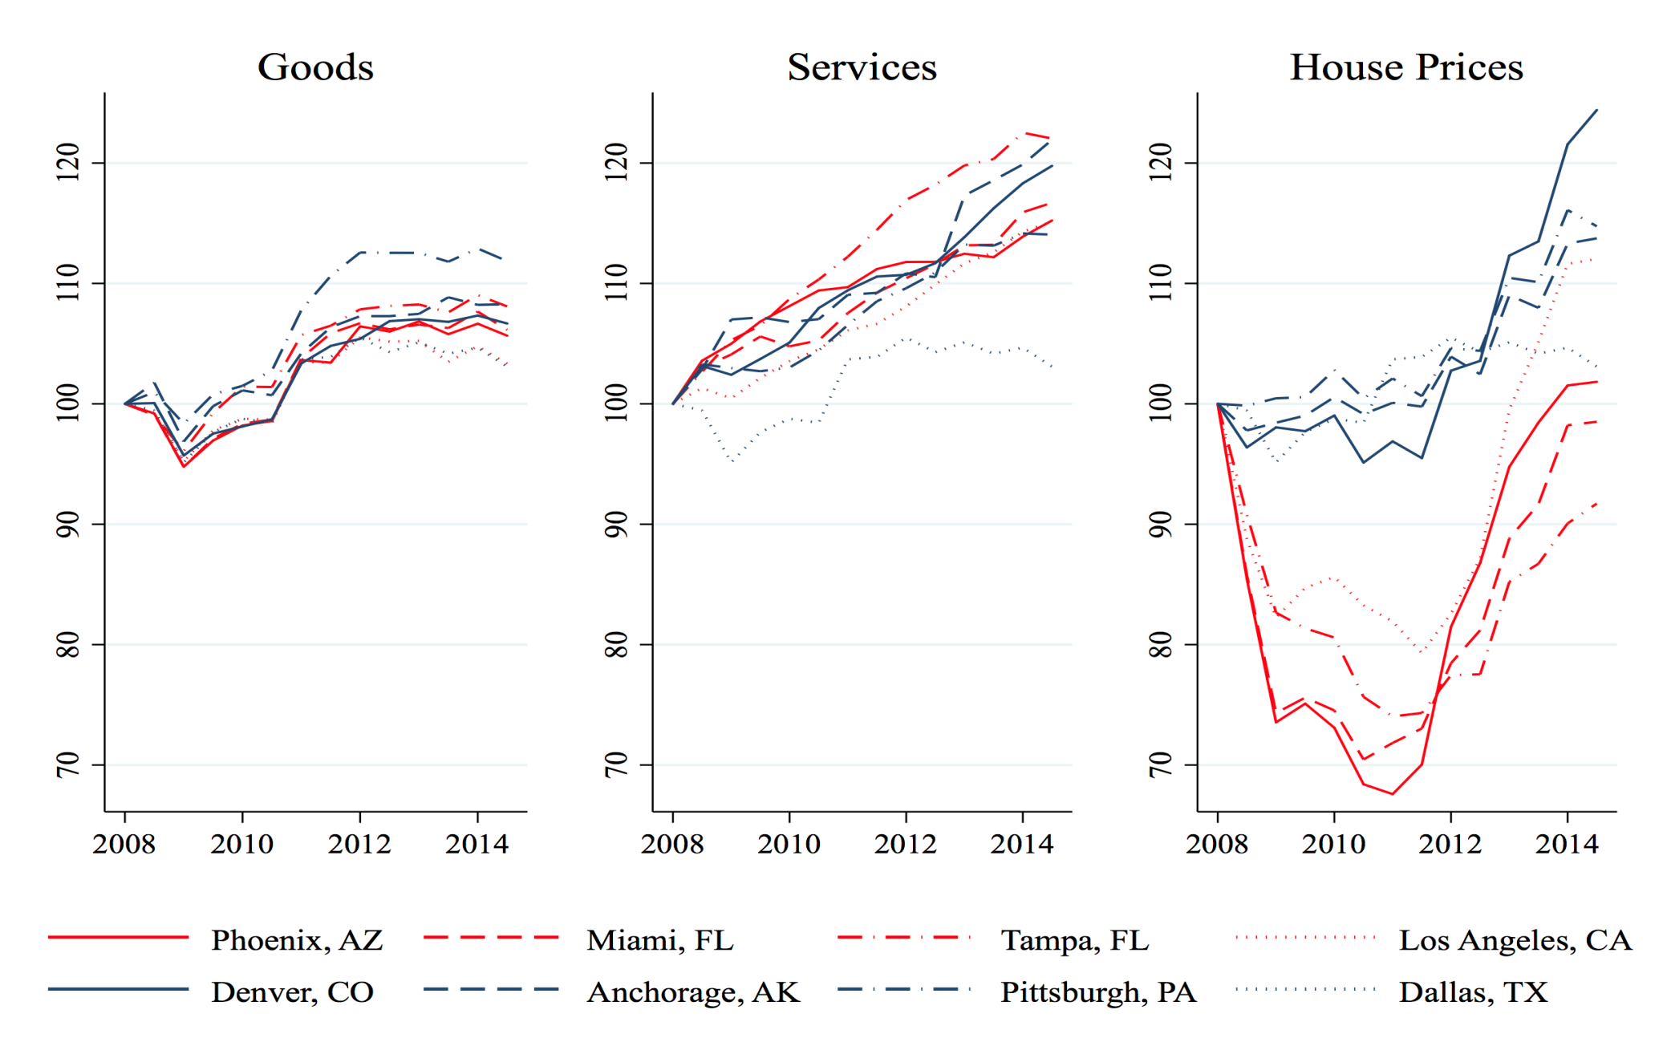
Relative prices & house prices, 2008-2011
Did real exchange rate (ex rents) fall with housing prices?
ln(rer) = 0.54*ln(price_{goods}) + 0.46*ln(price_{services})

Slide 4
This paper
Empirical analysis of relative price adjustment to housing bust in the Great Recession across US jurisdictions
Exploit two datasets of local consumption prices, combined with data on sectoral costs and activity:
  BEA Regional Price Parity (RPPs) for 380 MSAS
  BLS CPI data for 26+43 MSAs (extension to full sample under construction using micro data)
Decomposition of real exchange rate adjustment between goods and services (and rents) across US MSAs
Empirical approach: sectoral prices, employment, wages,…, regressed on local house prices as a measure of demand (both OLS and IV)

Slide 5
Main results
Lack of real exchange rate adjustment to asymmetric housing bust within the US during Great Recession (2008-2011)
Evidence that the relative price of (non-tradable) services does not fall more than relative price of (tradable) goods
  Relative price of goods falls with house prices (positive elasticity), but not always significantly
  Elasticity of relative price of services zero or even negative
Burden of adjustment on employment in the service and distribution sector, no effects in goods producing industries
  Insignificant elasticity of sectoral (nominal and real) wages per employee
  Insignificant elasticity of sectoral labor shares (inverse of markups)
  Yet firms exit all sectors during housing bust

Slide 6
Literature
Large body of contributions investigate link between regional prices and wages, and regional business cycles (seminal US paper by Blanchard & Katz 1992)
Recent growing literature (list is non-exhaustive):
  House price shocks and local employment and consumption: Mian, Rao & Sufi (2013), Mian & Sufi (2014), Aladangady (2016), Kaplan, Mitman & Violante (2016)
  Local prices based on store-level scanner data: Stroebl & Vavra (2014), Beraja, Hurst & Ospina (2016), Kaplan et al. (2016)
  Regional Phillips Curves: Fitzgerald & Nicolini (2014)
  Sectoral and regional adjustment to asymmetric shocks in currency areas: Philippon & Midrigan (2014), Martin & Philippon (2017), Beraja et al. (2016) – and Nakamura & Steinsson (2014) on fiscal shocks

Slide 7
Roadmap
Conceptual background
Empirical model
Data
Results

Slide 8

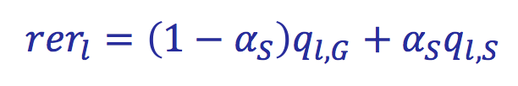
Relative prices across MSAs
Define real exchange rate (rer) as the relative price of consumption
  Changes in rer = regional inflation differentials
For any location ‘l’, define the relative price of goods G and services S with respect to national levels (for j=G,S)
  The consumption price of goods comprises both tradable components and local components (e.g., distribution, retail trade)
The rer (ex rents) in location “l” is the weighted sum of these relative prices with consumption weights:

Slide 9
Internal devaluation and non-tradability
Local demand effects on both relative prices and quantities should be larger in non-tradable (service) sectors
  Smaller incidence of imports/exports
  Larger deviations from law of one price/arbitrage
Under flexible prices, after a decline in local demand, the relative price of non-tradables falls by more than that of tradables
  This change in relative prices induces firms to produce less non-tradables when their demand falls
  Output, employment decline in the nontradable sector, may even increase in the tradable sector
Under nominal rigidities, larger adjustment falls on quantities

Slide 10
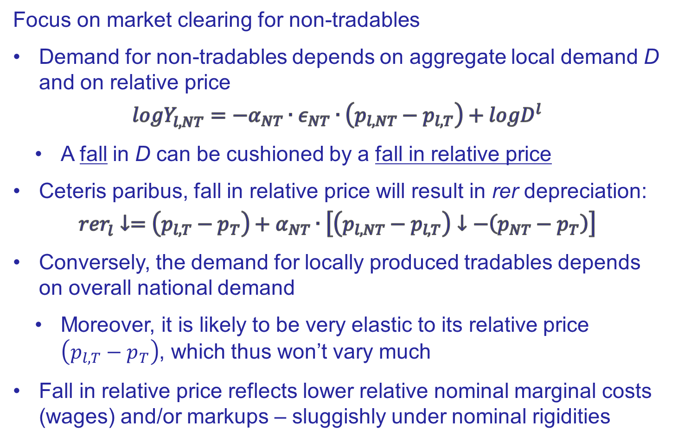
The adjustment mechanism
Focus on market clearing for non-tradables
Demand for non-tradables depends on aggregate local demand D and on relative price
$${logY}_{l,NT}^{}=−α_{NT}∙ε_{NT}∙\left(p_{l,NT}−p_{l,T}\right)+logD^{l}$$
  A fall in D can be cushioned by a fall in relative price
Ceteris paribus, fall in relative price will result in rer depreciation:
$${rer}_{l}^{}↓=\left(p_{l,T}−p_{T}\right)+α_{NT}∙\left[\left(p_{l,NT}−p_{l,T}\right)↓−\left(p_{NT}−p_{T}\right)\right]$$
Conversely, the demand for locally produced tradables depends on overall national demand
  Moreover, it is likely to be very elastic to its relative price $\left(p_{l,T}−p_{T}\right)$, which thus won’t vary much
Fall in relative price reflects lower relative nominal marginal costs (wages) and/or markups – sluggishly under nominal rigidities

Slide 11
Price adjustment and financial frictions
In the above framework, local house prices affect prices through the demand for goods and services, in turn determining the demand for local labor and wages, and thus marginal costs
However, further channels may be active, working through the effects of house prices on the value of collateral of firms
If a fall in the value of collateral exacerbates information asymmetries among borrowers and lenders, a fall in house prices can be expected to raise the cost of borrowing for firms
Borrowing costs may actually rise so much, that firms' prices increase, instead of falling, with a house price bust (see by Gertler, Schoenle, Sim & Zakraijsek 2016)
Adelino, Schoar & Severino (2014) find that this channel is strong during the housing boom period (2002-2007), but much less significant during the subsequent bust, which is the focus of our analysis

Slide 12
Roadmap
Conceptual background
Empirical model
Data
Results

Slide 13
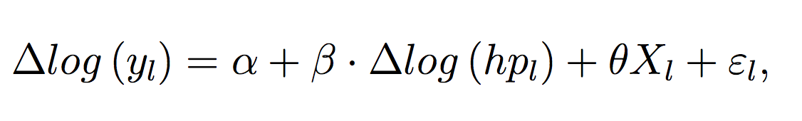
Empirical approach
We are interested in the relation between relative prices and house prices (taken as a measure of local demand) during the Great Recession
  Evidence of large and asymmetric effects of the housing bust across location in the US
OLS and IV, as in Mian & Sufi (2014), Stroebl & Vavra (2014)
OLS equation:
IV approach to identify local housing demand effects, since house prices hp may be correlated with other unobserved variables

Slide 14
IV Estimation
IV: housing supply elasticities from Saiz (2010) as in Mian & Sufi (2014) and Stroebl & Vavra (2014)
  During housing boom driven by US wide shock, house prices in less elastic areas increased by more
  During bust, the very same areas also experienced the largest drop (1st stage positive coefficient)
  Uncorrelated with other local shocks such as productivity
Robustness: Panel IV interacting housing supply elasticities from Saiz (2010) with 10-year US interest rate as Aladangady (2016), Sraer et al. (2012)
  Higher interest rate should have less negative impact on house prices if supply is more elastic (1st stage positive coefficient)

Slide 15
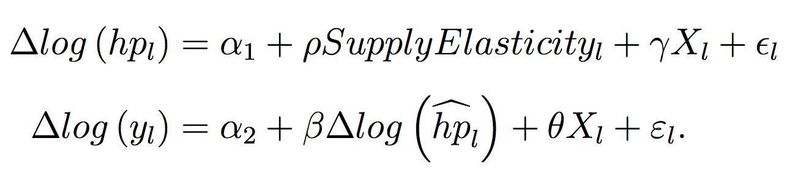
Empirical specification
IV regression on the log-level of local house prices, controlling for other MSA observables X (demographics)
First and second stages:
Dependent variables in each sector (j)
  MSA relative consumer prices; nominal and real (consumption) wages; employment; number of firms and establishments; labor shares
  We also look at additional variables at overall MSA level, including population, unemployment and unit labor costs

Slide 16
Roadmap
Conceptual background
Empirical model
Data
Results

Slide 17
Data
Regional consumer price parities (RPPs) from the BEA (380 MSAs over the period 2008 - 2011)
  Regressions run on full sample and on the largest 97 MSAs with distinct RPPs, for both goods and services
For a subset of (largest) 26+43 PSUs/MSAs longer time series from BLS CPI data since 1980s – 43 aggregated in 4 larger areas
Census data: Employment and payroll data – County Business Patterns dataset
# of firms and establishments – Statistics of US Business dataset
Nominal GDP for NAICS sectors from BEA
House prices at the zip code level by Core Logic
Sector definitions: Goods and services in line with break down in BEA-BLS prices, keeping distribution and construction separate

Slide 18
Regional samples

Slide 19
Goods prices across close areas

Slide 20
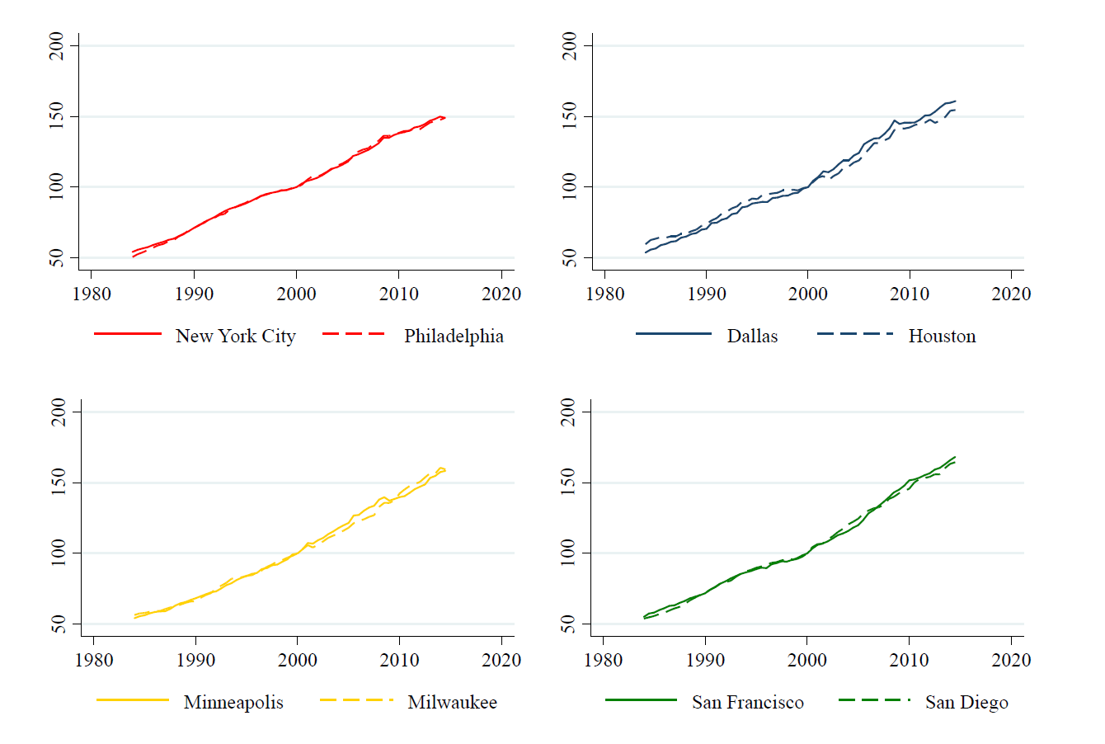
Services (ex-rents) prices across close areas

Slide 21
Sectors classification
Goods
  NAICS 11: Agriculture, forestry, fishing & hunting
  NAICS 21: Mining, quarrying & oil, gas extraction
  NAICS 31-33: Manufacturing
Distribution
  NAICS 42: Wholesale trade
  NAICS 44-45: Retail trade
Services
  NAICS 22: Utilities
  NAICS 48-49: Transportation & Warehousing
  NAICS 51-56: Information, Finance, Real estate, Professional,
  NAICS 61-62: Education & Health Care
  NAICS 71-72: Entertainment, Recreation, Accommodation & Food
  NAICS 81: Other privately provided services
Construction
  NAICS 23

Slide 22
Roadmap
Conceptual background
Empirical model
Data
Results

Slide 23
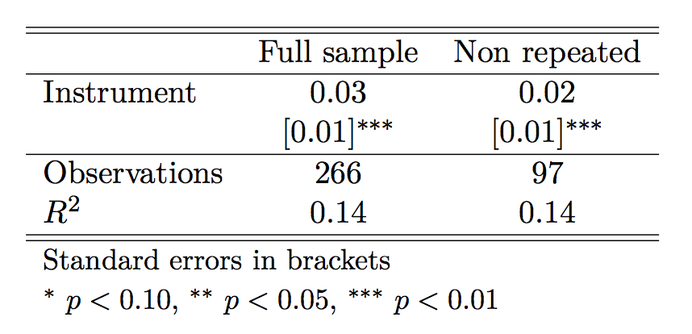
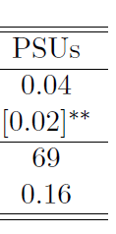
Estimation: First stage for house prices
Null of weak instrument rejected at 1% (***)

Slide 24
First set of results
Hard to detect internal devaluation after asymmetric house price shocks during the Great Recession (2008-2011)
  Goods prices: zero/(weakly) positive elasticity
  Services: zero/(weakly) negative elasticity
  Rents: positive elasticity
Similar pattern in dataset for BLS 69 PSUs/MSAs, also with finer sectoral breakdown
Conversely,
Strong response of MSA unemployment and sectoral employment
  Employment in services and distribution falls with house prices
  Much weaker response of employment in goods

Slide 25
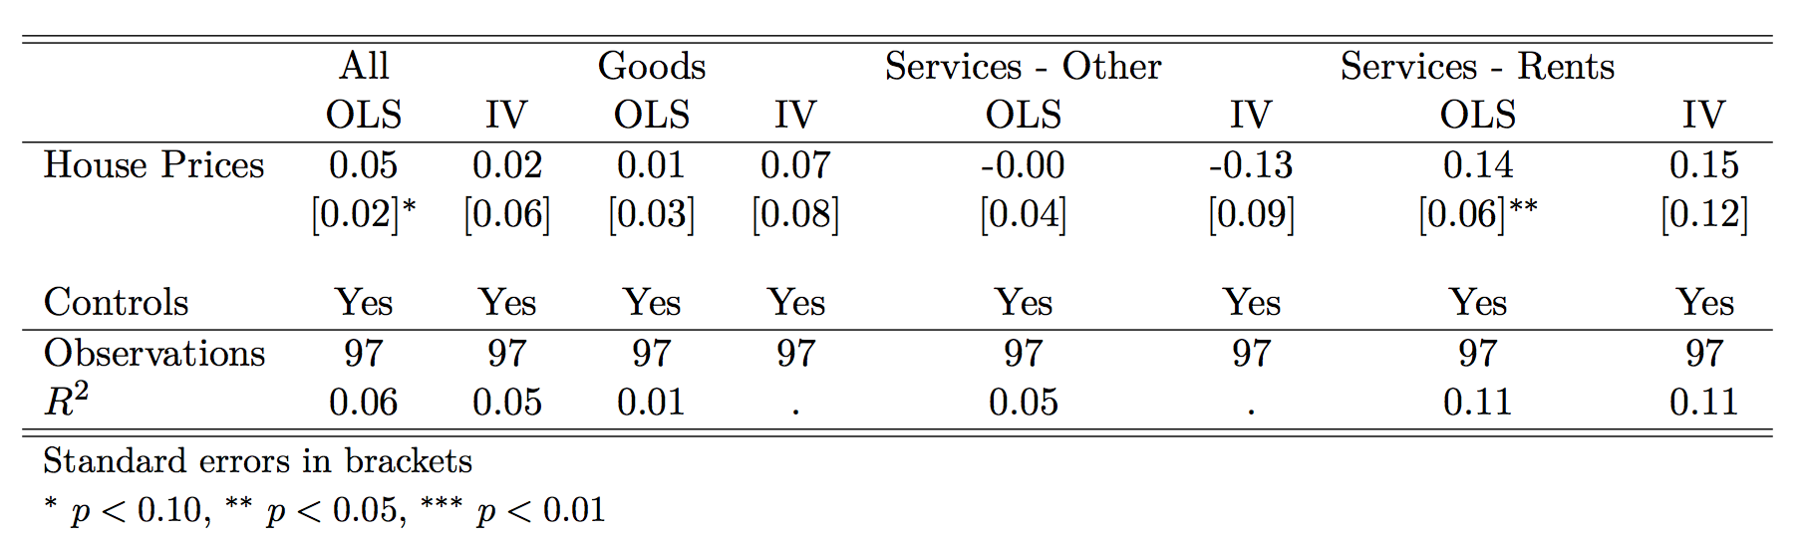
Results: RPPs (97 MSAs, 2008-2011)
Robust std. errors clustered by State in brackets.

Slide 26
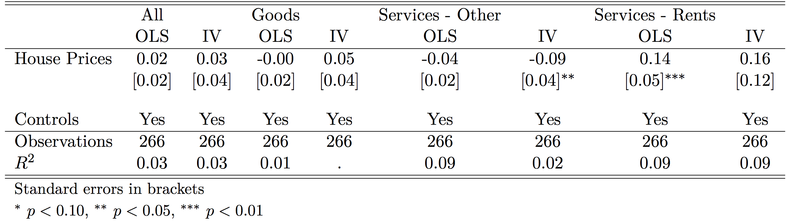
Results: RPPs (all MSAs, 2008-2011)
Robust std. errors clustered by State in brackets.
Results confirmed in sample of all MSAs, but only rents not repeated across all MSAs

Slide 27
Results: CPI (69 PSUs/MSAs, 2008-2011)
Robust std. errors clustered by State in brackets.
Food prices elasticity positive as in Stroebl & Vavra (but smaller)

Slide 28
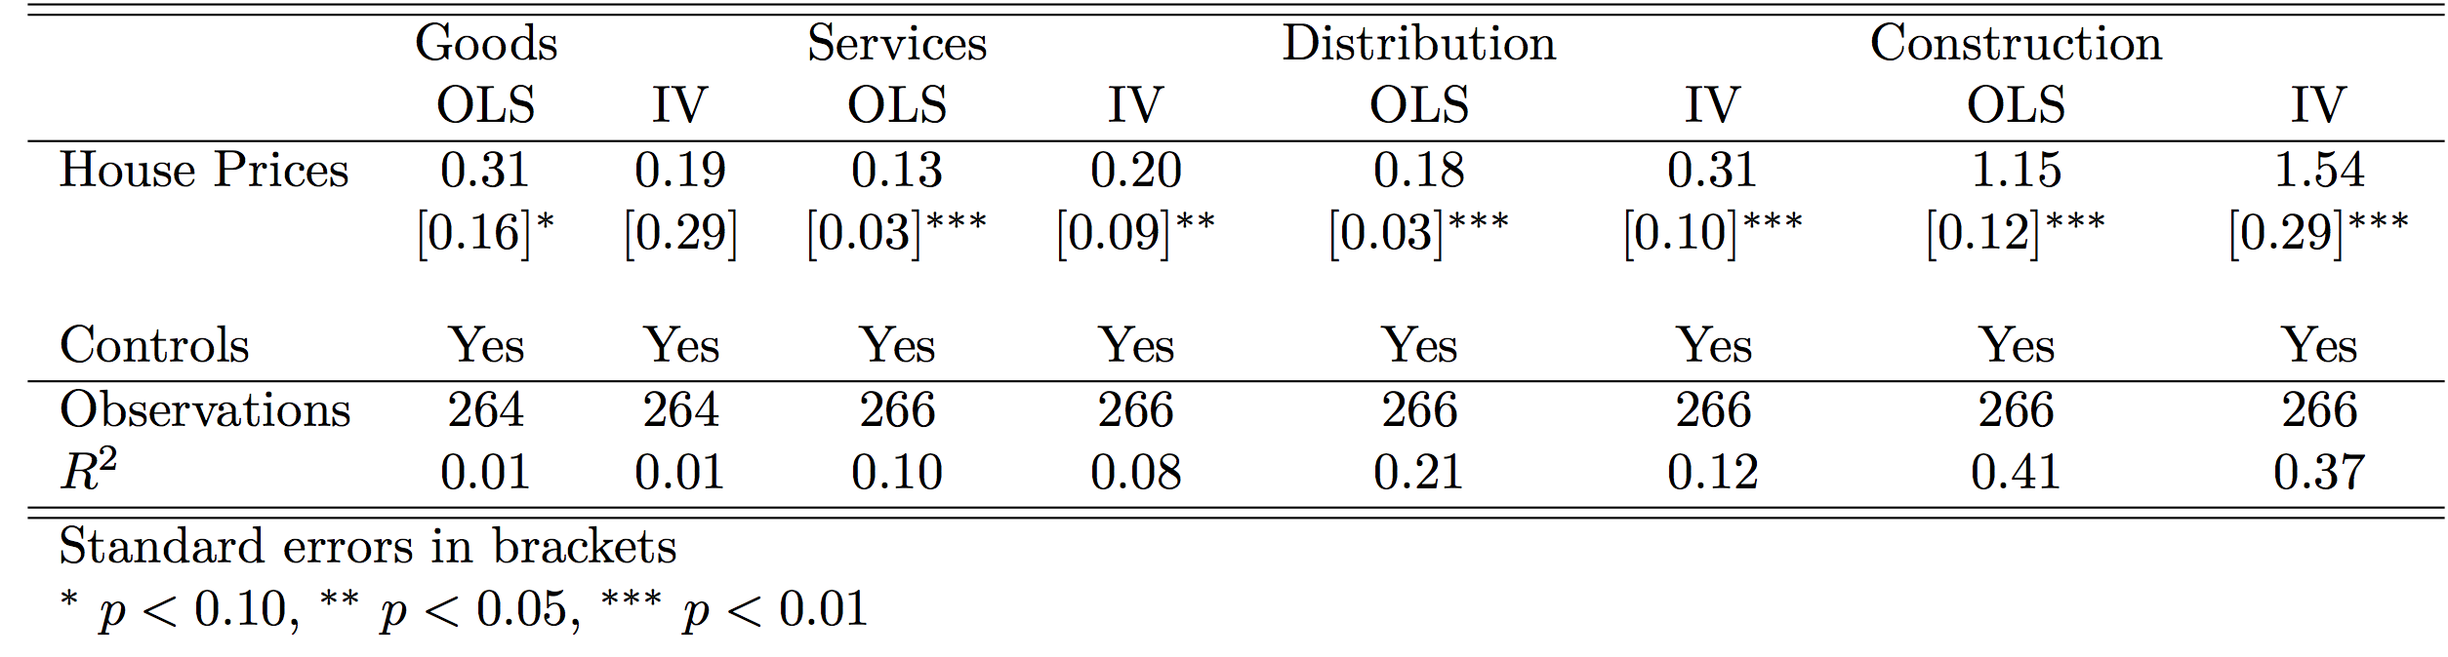
Results: Employment (all MSAs, 2008-2011)
Robust std. errors clustered by State in brackets.
Larger positive elasticity with IV but for goods consistent with identification of local demand effects

Slide 29
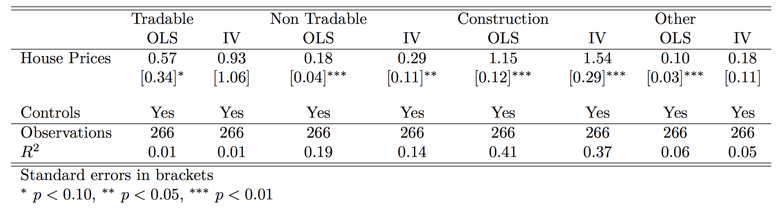
Results: Employment (Mian-Sufi sectors)
Robust std. errors clustered by State in brackets.
Sectors defined as in Mian & Sufi (2014), comparable results

Slide 30
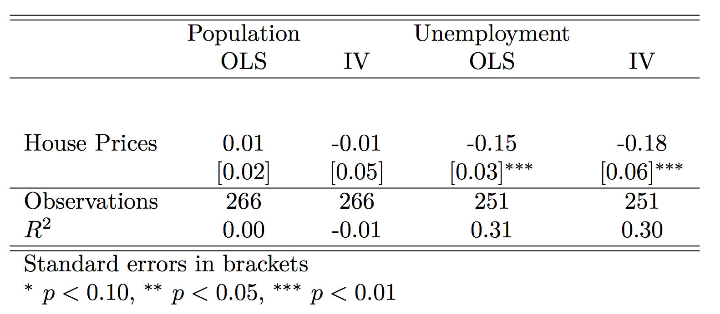
Results: Labor markets (all MSAs, 08-11)
Robust std. errors clustered by State in brackets.
Employment losses raise overall unemployment

Slide 31
Summary of results so far
Lack of evidence of internal devaluation after asymmetric house price shocks during the Great Recession (but for goods such as food and nondurables)
Despite larger elasticity of sectoral employment, response of relative price of services similar to relative price of goods
What about determinants of price dynamics like wages and markups? Next:
  Little response of nominal and real (consumption) wages per employee across sectors
  Number of firms, establishments positively correlated across all sectors, but lower competition more important in non-tradables
  Yet little response of labor shares (inverse of markup with Cobb-Douglas production)

Slide 32
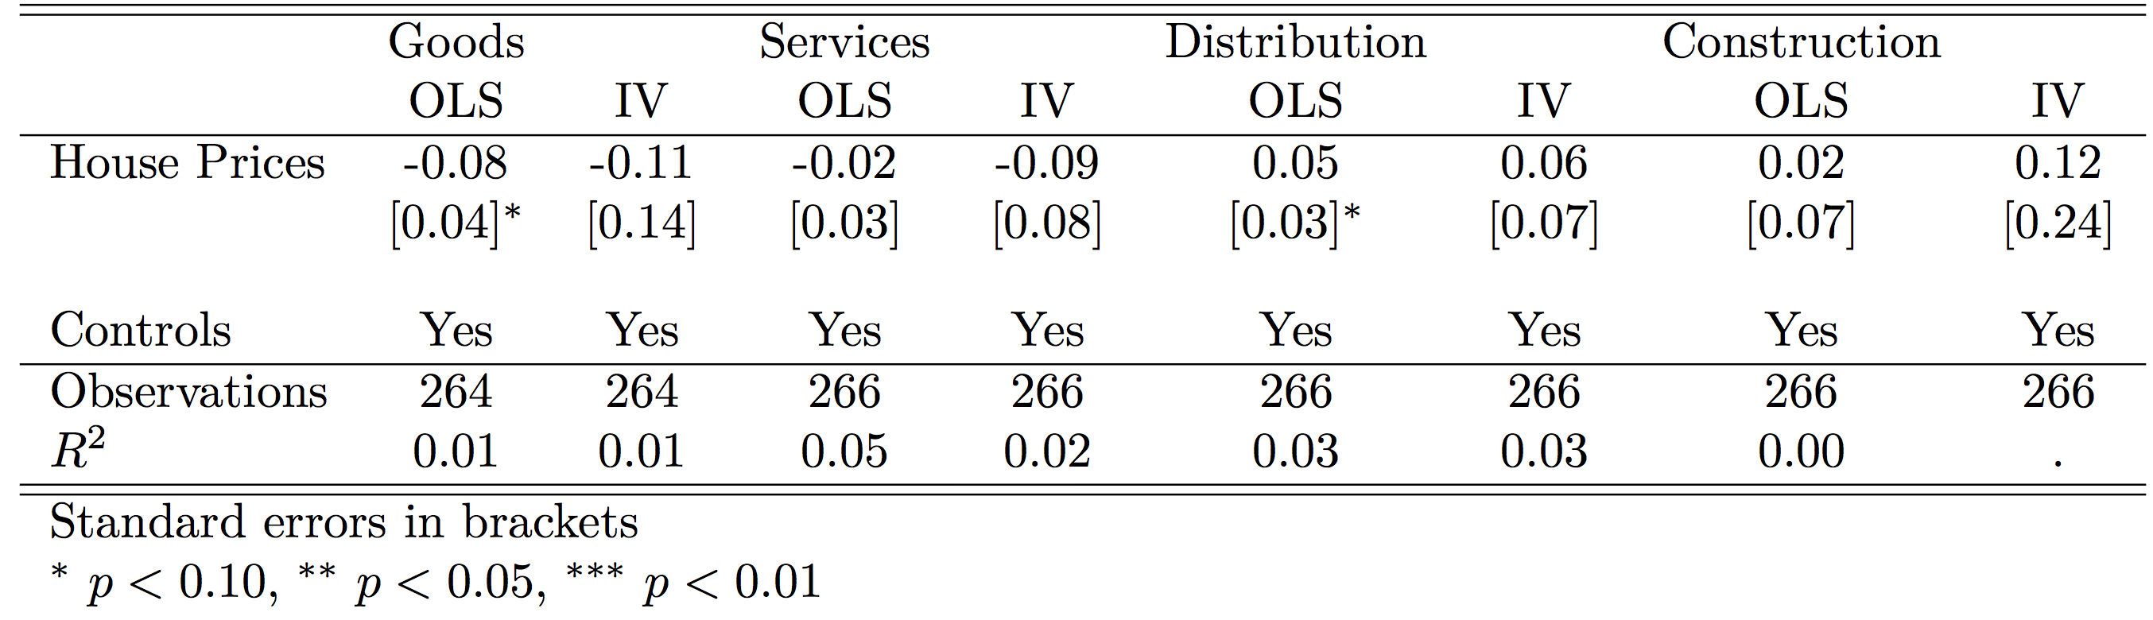
Results: Nominal wages (all MSAs, 08-11)
Robust std. errors clustered by State in brackets.
Only sectoral wage per employee available, but not ideal (Beraja et al. 2016)

Slide 33
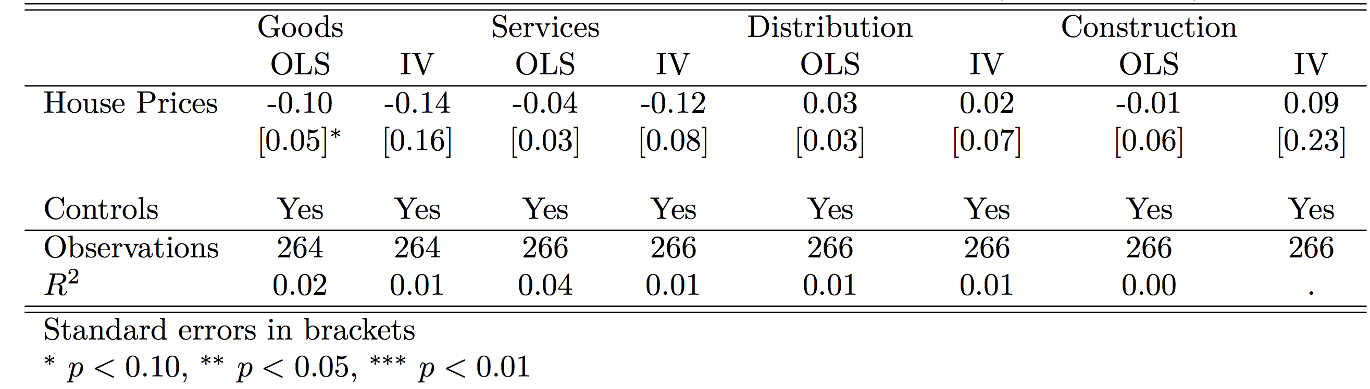
Results: Real wages (all MSAs, 08-11)
Robust std. errors clustered by State in brackets.

Slide 34
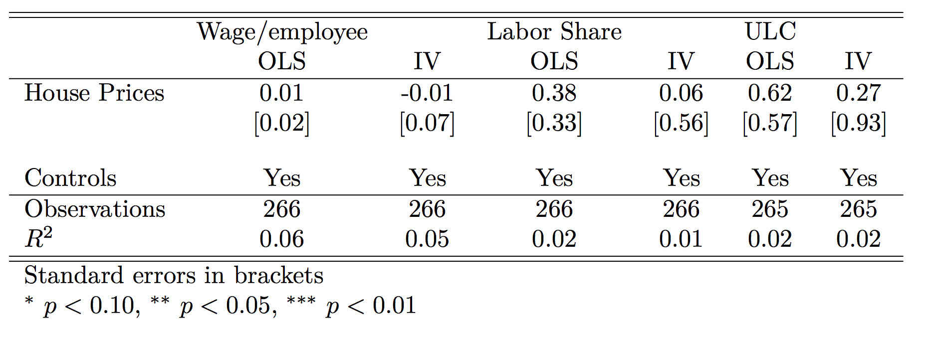
Results: Wages, Labor share, ULC (all MSAs)
Robust std. errors clustered by State in brackets.
ULC available only for total GDP, not significantly affected

Slide 35
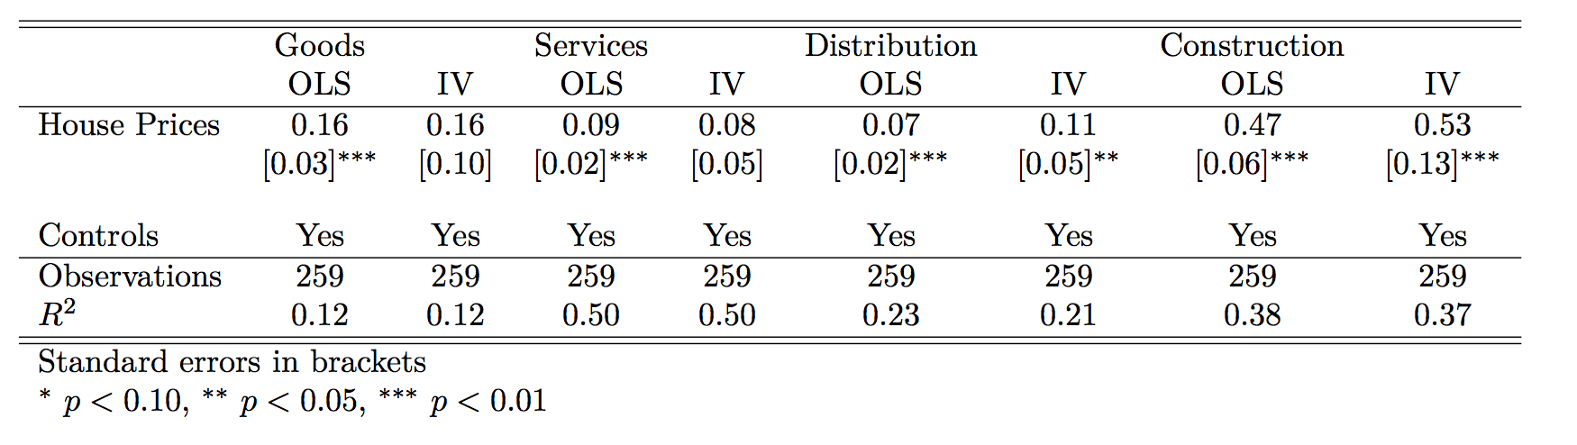
Results: Number of establishments (all MSAs)
Robust std. errors clustered by State in brackets.
Lower net entry should matter more for competition in (non-traded) services, distribution

Slide 36
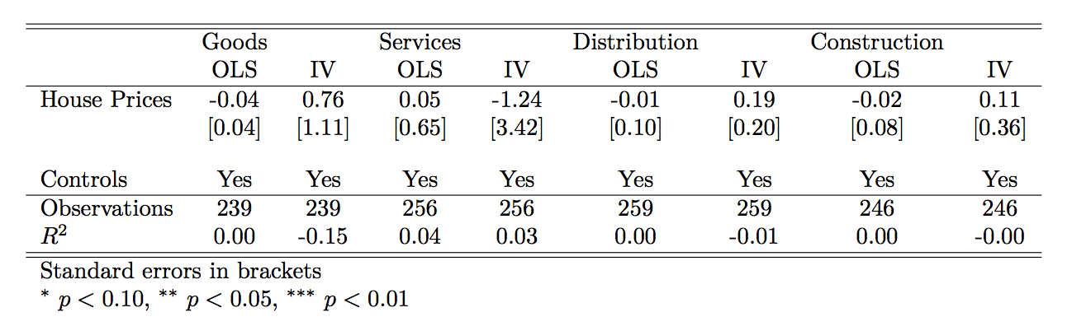
Results: Labor shares (all MSAs, 08-11)
Robust std. errors clustered by State in brackets.
Labor share proportional to markups under Cobb-Douglas production function

Slide 37
Summary of results on price determinants
Little response of nominal and real (consumption) wages per employee across sectors
Number of firms, establishments positively correlated across all sectors, but lower competition more important in non-tradables
Yet little response of labor shares (inverse of markup with Cobb-Douglas production)
Unfortunately we do not have direct measures of real marginal costs, could it be that they increased in the bust (“collateral” channel)?
Yet to account for our results, this channel should have different intensity across sectors (see Adelino et al. 2012)

Slide 38
Some robustness
  Similar results in a few robustness exercises:
  Panel regressions with Saiz elasticity interacted with US 10y rate
  Controlling for firm entry, level of competition
  Boom period (2001-2007) with longer BLS-CPI sample

Slide 39
Boom period: CPI (69 PSUs/MSAs, 2001-2007)
Robust std. errors clustered by State in brackets.
Similar to bust, food prices elasticity positive again as in Stroebl & Vavra

Slide 40
To conclude
  Little relative price adjustment in the US during the Great Recession, puzzling in light of open-economy and macro theory
  The bulk of adjustment to local demand shocks should fall in sectors with largest incidence of nontradability
  However, adjustment fell almost exclusively on employment, relative price of services may even have moved the wrong way
  Lack of connection between demand and price dynamics in the Great Recession, not only over time but also across US MSAs
Further work:
    Exploit BLS CPI microdata to obtain full sample of 69 MSAs from 1980s
    Further investigation of “cost channel” vs markup adjustment

Slide 41
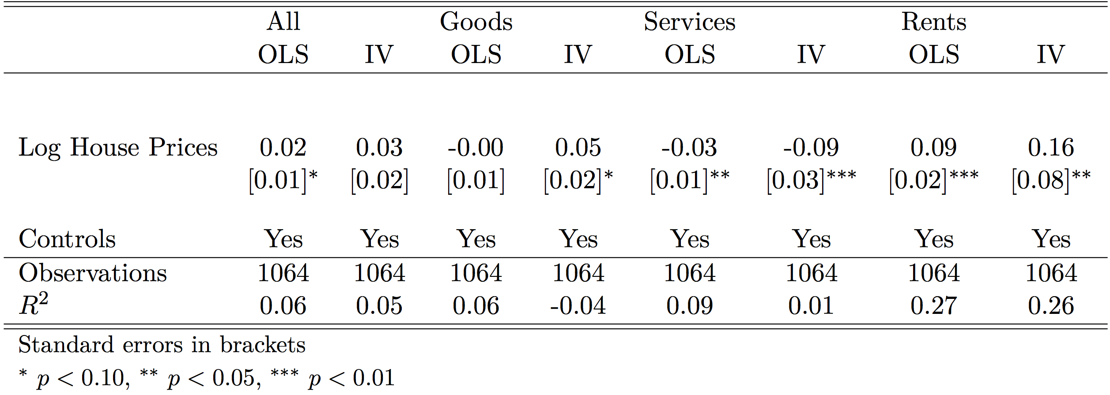
Panel regressions (all MSAs, 2008-2011)

Slide 42
Panel regressions (BLS 69 PSUs/MSAs, 08-11)
Stronger evidence of internal devaluation driven by goods

Slide 43
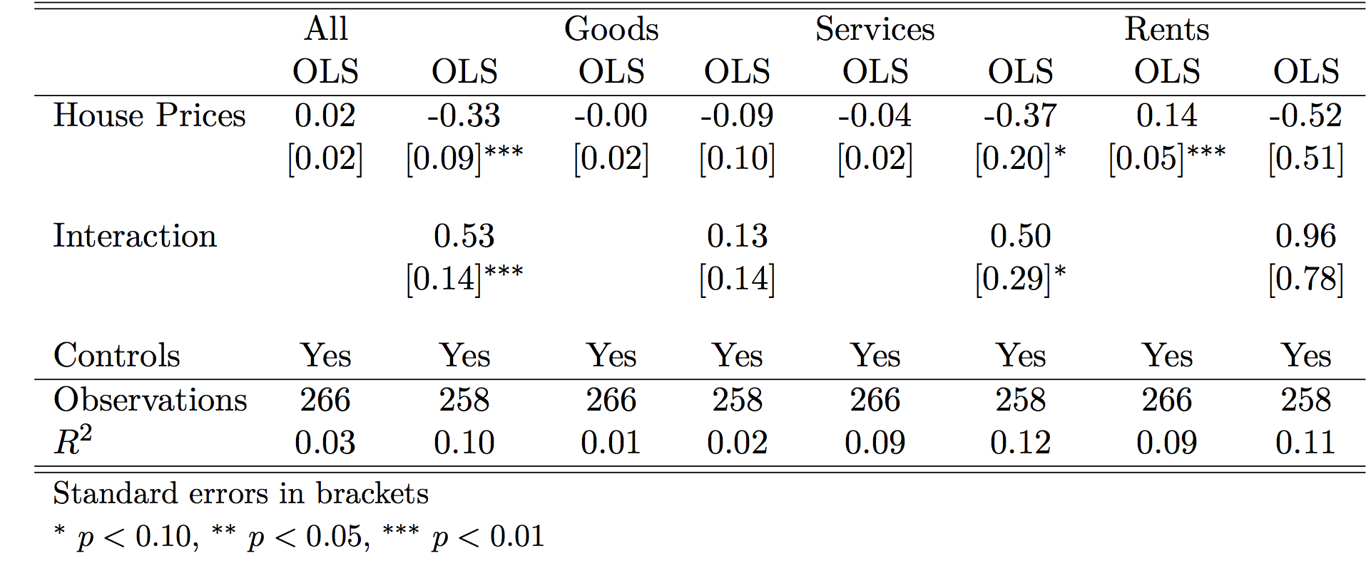
Adding interaction (all MSAs, 08-11)
Robust std. errors clustered by State in brackets.
Demand effects should be stronger for home owners;
Elasticity is more positive where ownership rate larger

Slide 44
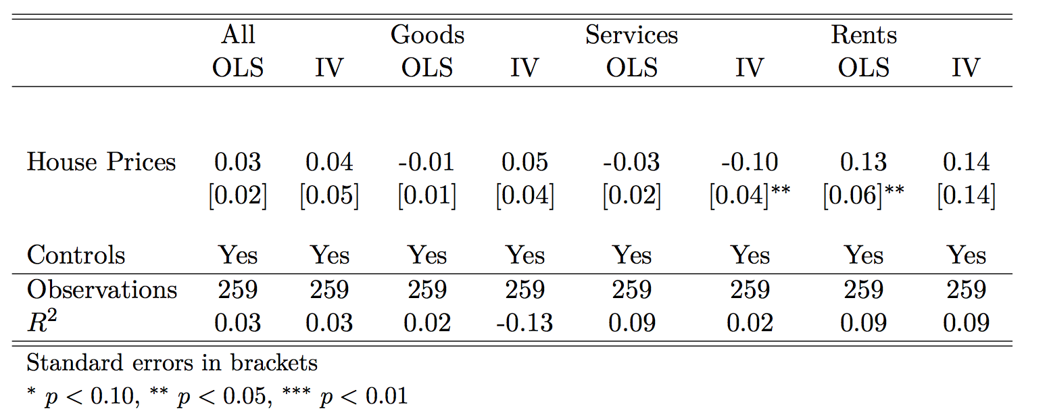
Robustness: Control for firm net entry
In MSAs where it is difficult to build, it could be difficult for new firms to enter

