Slide 1
Discussion of the paper “Credit misallocation during the European financial crisis” by F. Schivardi, E. Sette and G.Tabellini
Paloma Lopez-Garcia
European Central Bank
First Annual Workshop of ESCB Research Cluster 2
Madrid, 16-17 November 2017
Disclaimer: the opinions expressed in this presentation are those of the authors and do not necessarily reflect the views of the ECB of the European system of Central Bank.

Slide 2
This paper is extremely relevant, comprehensive, well done and nice to read
Great paper
Research questions:
Do Italian banks with low capital extend excessive credit to weak firms? (to comply with more stringent capital requirements during and after the crisis)
If yes, what is the impact on healthy firms’ performance? and on allocative efficiency?
To carry out the analysis, the authors construct a new dataset resulting from the merge of 3 databases:
Firm registries:
balance sheet of ALL limited liability firms
Credit register:
information on all loans granted by Italian banks
Supervisory reports: balance sheets of all banks

Slide 3
Main comments
Definition of zombie firms:
Issue with negative profit firms
First result: Weak banks extended relatively more credit to zombie firms during the crisis than well capitalised banks
Comment on some by-results
Second result: The increase in zombie lending did not affect the performance of healthy firms and had little impact on AE
Impact of the “whatever it takes” and LTROs
Strategy to solve the identification issue stemming from the fact that a shock affects differently zombies and non-zombies
Strategy to analyse the impact of zombie lending on credit misallocation

Slide 4
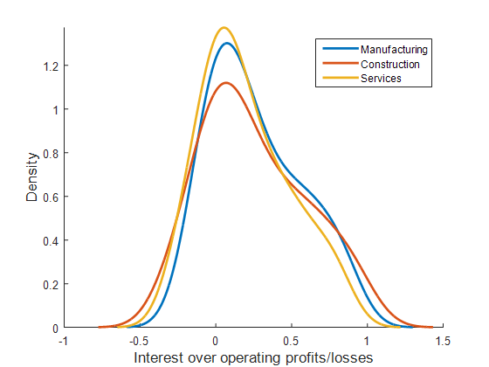
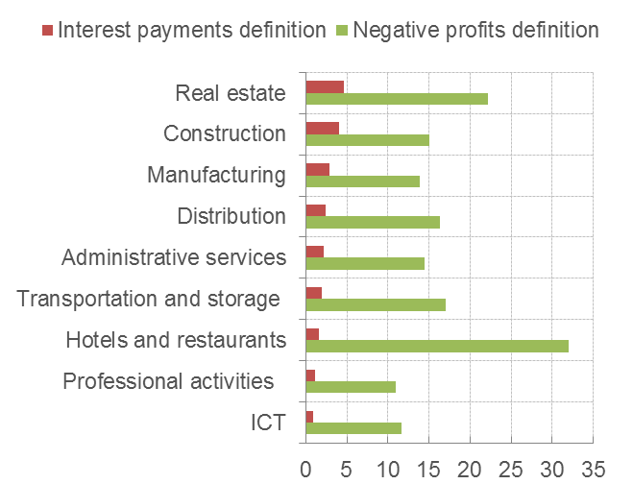
Zombie firms’ definition
3 different definitions (consider 3-year averages of variables):
ROA_{t} < PRIME_{t} & Leverage_{t} > L preferred
Profit_{t}/interest payment_{t} < 1 & Leverage_{t} > L
(Two) Continuous zombie indicators equal to PC of different sets of variables
Distribution of interests over profits, Portugal (2010-2013)
Share of zombies, different definitions, Portugal (2010-2013)
Zombies
=
negative profits
Zombies
conditioned on positive profits
Healthy firms
Note: Interest payment definition refers to a firm which in two consecutive years did not have enough profits to cover interest payments; negative profits definition is here a firm with negative profits for two consecutive years.
Source: New CompNet code run on Amadeus data for Portugal (2010-2013)

Slide 5
Why is this important?
Firms with low, but positive, profits are significantly different from firms with persistent negative profits
Maybe results would differ for different zombie types (impact on healthy firms and on aggregate activity)
Share of zombie firms by size decile, Portugal (2010-2013)
Share of zombie firms by TFP decile, Portugal (2010-2013)
Source: New CompNet code run on Amadeus data for Portugal (2010-2013)
Note: Interest payment definition refers to a firm which in two consecutive years did not have enough profits to cover interest payments; negative profits definition is here a firm with negative profits for two consecutive years.

Slide 6
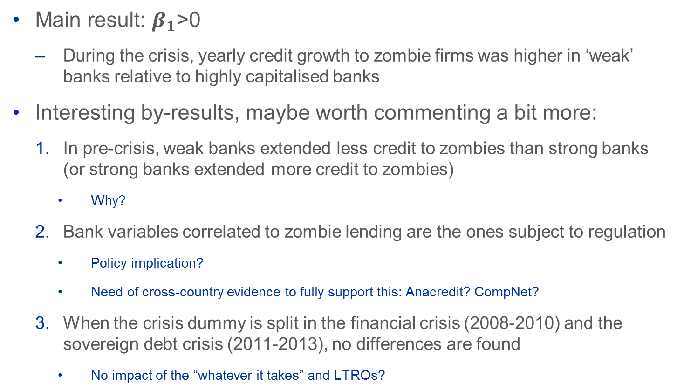

DV: Change in credit conditioned on continuation of relationship; Coefficient of interest: $β_{1}(Z_{it}×{Lowcap}_{jt}×crisis)$
Do banks with low capital extend excessive credit to zombies?
Main result: $β_{1}$>0
During the crisis, yearly credit growth to zombie firms was higher in ‘weak’ banks relative to highly capitalised banks
Interesting by-results, maybe worth commenting a bit more:
In pre-crisis, weak banks extended less credit to zombies than strong banks (or strong banks extended more credit to zombies)
Why?
Bank variables correlated to zombie lending are the ones subject to regulation
Policy implication?
Need of cross-country evidence to fully support this: Anacredit? CompNet?
When the crisis dummy is split in the financial crisis (2008-2010) and the sovereign debt crisis (2011-2013), no differences are found
No impact of the “whatever it takes” and LTROs?

Slide 7
Economic consequences of zombie lending (I)
Analyse the impact of zombie lending on healthy firms
We expect an impact because zombie firms “crowd out” scarce credit and zombie lending distorts competition
But no impact is found on the performance of healthy firms
…what if credit was not so scarce?
“(…) these measures should ensure enhanced access of the banking sector to liquidity and facilitate the functioning of the euro area money market. They are expected to support the provision of credit to households and non-financial corporations.”
Mario Draghi 2011, excerpt from the announcement of the two 36-month longer-term refinancing operations (LTROs)
Could this massive liquidity injection explain the lack of crowd out, and lack of impact on the absolute performance of healthy firms?

Slide 8
Economic consequences of zombie lending (II)
Introduction of a new strategy to tackle the problem stemming from the fact that a negative local shock might affect differently zombies and non-zombies
Reasoning based on a normal distribution of firm performance
Would results hold if firm performance did not follow a normal distribution?
Productivity distribution, Italy
Source: CompNet, 5th vintage
Note: Firms with at least 20 employees

Slide 9
Economic consequences of zombie lending (III)
Analysis of the impact of zombie lending on misallocation of resources
Use sd(TFPR) as an indicator of resource misallocation (HK 2009)
Control for local shocks with the growth in average TFPR in the market
No significant effect found…this is the most surprising result of the paper
…
But average TFPR growth is the outcome of resource misallocation…reverse causality??
Why not using directly aggregate TFPR growth as the DV?
You could then also account for the direct impact on aggregate TFP of reduced exit of non-viable, and less productive, firms
Use of alternative indicators of resource misallocation as a check??

Slide 10

Thanks!!

Slide 11
CompNet: some news
CompNet is a micro-aggregated database of competitiveness and financial indicators covering a large part of the EU countries
Useful to include it in our research toolkit
The new release of CompNet will be ready in 2018Q1
Will cover data from early 2000 to 2015 (2016 in some cases)
Participation: 21 countries + UK (tbc)
NCBs: HR, CZ, DK, HU, LI, PO, SK, SZ
NSIs: SE, FI, FR, DE, IT, NE, EE, MA
Other sources: ESRI (IE), Univ. Ljubliana (SI), IWH (DE), BACH micro-data (SP, BE, PT)
Will include a new module on zombie firms
3 definitions of zombies: interest-profit ratio, negative profits and negative profits excluding HGF
Information on descriptives (including TFP, misallocation and financial ratios) of zombies and non-zombies in a given country-sector-size class-year
Share of zombies in each decile of firm performance distribution (TFP, size, growth)

