Slide 1
Output Gaps and Inflation in Canada
October 16, 2017
Lise Pichette, Marie-Noëlle Robitaille, Mohanad Salameh and Pierre St-Amant
Canadian Economic Analysis
Bank of Canada
Notes:
Thank the organizers for inviting me to this conference.
Joint work with Lise Pichette, Marie-Noelle Robitaille and Mohanad Salameh.

Slide 2
The views expressed in this paper are solely those of the authors and may differ from official Bank of Canada’s views. No responsability for them should be attributed to the Bank.

Slide 3
Outline
Introduction
Methodology
Real-time data sources
Output gap methods
Output gap estimates and data revisions
Inflation forecasting results
Conclusions

Slide 4
Introduction
Link between output gap and inflation is central to the conduct of monetary policy.
But the usefulness of output gaps to forecast inflation has been questioned (Orphanides & van Norden, 2005; Edge and Rudd, 2016; Cayen & van Norden, 2002; Champagne, Poulin-Bellisle and Sekkel, 2016; etc.)
Guérin, Morin & Mohr (2015): some output gaps can improve inflation forecasts in Europe.
We revisit the issue with Canadian data.
Notes:
When the level of real GDP exceeds its potential (the output gap is positive) the economy is subject to inflationary pressures. In such circumstances, inflation-targeting monetary authorities tend to tighten their policy in order to keep forecasted inflation at target. Conversely, they tend to ease their policy when real GDP is below potential.
Orphanides and van Norden: ex-post vs real-time output gap to predict inflation in the US.
[Edge and Russ: real-time US federal reserve output gaps. Neither ex-post or real-time in the US.
Cayen and van Norden: In Canada, most output gaps do not improve the inflation forecasts of simple autoregressive models.
Champagne, Poulin-Bellisle and Sekkel: Bank of Canada’s staff projections and other simple measures. Neither ex-post or real-time helps in Canada.]
Guérin, Morin & Mohr: some output gaps can improve forecasts compared to simple AR. Combining output gaps does not necessarily improve inflation forecasting results but reduces the size of revisions.

Slide 5
Introduction
Our main contributions:
Assess methods used, or recently proposed, to measure output gap in Canada.
Take into account data revisions for a large number of variables serving as inputs into output gap calculations.
Examine output gaps’ ability to predict new measures of Canadian core inflation.
Examine whether labour input gaps, simple combinations of gaps and forecasted output gaps can help forecast inflation in Canada.
Notes:
The real-time data used in the studies discussed above have usually been limited to real GDP (or directly to output gaps produced by policy institutions).
CPI-trim, CPI-median and CPI-common. Announced in late-2016.

Slide 6
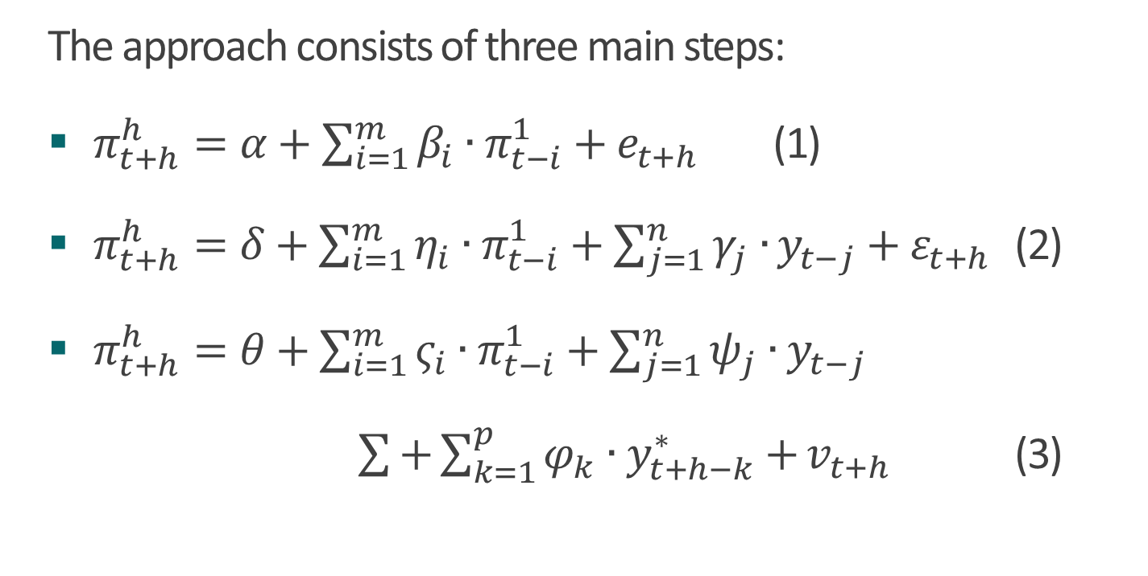
Methodology
The approach consists of three main steps:
$π_{t+h}^{h}=α+\sum_{i=1}^{m}{β_{i}∙π_{t−i}^{1}}+e_{t+h}$ (1)
$π_{t+h}^{h}=δ+\sum_{i=1}^{m}{η_{i}∙π_{t−i}^{1}+\sum_{j=1}^{n}{γ_{j}∙}}y_{t−j}+ε_{t+h}$ (2)
$π_{t+h}^{h}=θ+\sum_{i=1}^{m}{ς_{i}∙π_{t−i}^{1}+\sum_{j=1}^{n}{ψ_{j}}}∙y_{t−j}$
$\sum{+\sum_{k=1}^{p}{φ_{k}∙y_{t+h−k}^{∗}}+}v_{t+h}$ (3)
Notes:
Orphanides and van Norden’s basic idea is to study whether output gaps, measured up to the latest available quarter of actual real GDP data, can add useful information to simple forecasting models based on passed inflation.
We follow these authors’ approach but add to it an examination of whether output gap projections could improve inflation forecasts.
We also examine whether replacing output gaps with labour input gaps or simple combinations of gaps improves forecasts.
We examine the output gap’s ability to forecast inflation at t+1, t+2 and t+4
We use the Schwartz criterion to specify equation 1, which is simple made of lags of inflation.
We then re-estimate that equation in and use the resulting models to perform inflation forecast.
We begin the experience in 2007q1 as this the first quarter for our real-time data set.
We use a an expanding sample starting in 1992q4, as this is the first quarter for which the Bank of Canada set a specific inflation target.
Various studies have shown that there has been a break in inflation series in Canada around the adoption of inflation targets.
We do the same with inflation forecating equation including output gaps, as in equation (2) and forecasted output gaps, as in equation (3).
To forecast the inputs needed to forecast output gaps we use real time Bank staff monitoring data + simple assumptions, in our base case.
Projections: only take into account the information available at the time inflation forecasts were made. No information obtained after period t is included in these projections.
To compare the models’ forecast performances, we calculate and compare their root mean-square errors (RMSEs). Comparisons of forecasts with (2) and (1) give us information about whether output gaps estimated with historical data add information to simple autoregressive models in forecasting inflation. Comparisons of (3) with (1) tells us whether adding historical and projected output gaps helps improve inflation forecasts.

Slide 7
Real-time data sources
Bank of Canada started collecting vintages of various series in the early 2000s.
But for most of our variables the vintages exist since 2006-2007: Paul Gilbert.
The various sources were put together in project I was involved in with the Bank’s IT.
Our database includes vintages of Statistics Canada data, of variables generated by Bank staff and of projections.
Also includes Statistics Canada special requests.

Slide 8
Methods to measure the output gap
Simplified Integrated Framework (SIF) (Pichette et al, 2015)
Modified Extended Multivariate Filter (EMVF) (Butler, 1996; Pichette et al, 2015)
Output gaps used in staff’s economic projections (Champagne, Poulin-Bellisle, Sekkel, 2016)
IMF method (Blagrave et al, 2015)
Multivariate State-Space Framework, MSSF (Pichette, Robitaille and Bernier, forthcoming)
Other simple filters: Hodrick-Prescott and Band-Pass
Notes:
Two main methods used by the Bank:
IF: production-function type of approach that decomposes potential output into trend labour input and trend labour productivity. Trend labour input: working-age population, trend employment rate and trend average weekly hours. Trend labour productivity: capital deepening (capital stock per hour worked) and trend total factor productivity. Because real-time data do not exist for some of the variables used in the IF, in this project we use a simplified version of it. The simplified and the full IF give very similar estimates.
EMVF: Mix of mechanical filtering (Hodrick-Prescott filter), end-of-sample conditions and conditioning information applied to labour productivity and to components of labour input (participation rate, unemployment, average hours worked).
Staff projections: reflects the judgment of the staff and is based on a large set of information, including:
the IF, the EMVF, output gap measures based on other methods, various labour market indicators, and some survey indicators.
IMF method: a state-space model requiring information on only a few variables to estimate potential output (real GDP growth, CPI inflation, unemployment rate, and output and inflation expectations from consensus forecasts). In this method, real GDP is subject to three types of shocks: a level-shock term to potential, a shock to potential growth, and a demand shock to the output gap.
MSSF: builds on the IMF method, but decomposes potential into trend productivity and trend labour input. Re-write the EMVF.
Simple filters.
Replace lags of output gaps with lags of GDP growth.

Slide 9
Labour input gaps and combinations
Three models estimate labour input gaps: SIF, EMVF, MSSF
Three simple combination methods: mean, median, common component of all output gaps
Mean of SIF and EMVF and mean of SIF and MSSF also examined

Slide 10
Output gap estimates and data revisions

Slide 11
Chart 1: Output gap estimates using our latest vintage
Notes:
Series constructed using the latest available vintage (2016Q2).
Methods using mechanical filters (HP filter, BP filter and EMVF) produce output gaps that are less persistent.
While the latest cycle looks largely similar across the approaches in terms of the depth of the 2008-09 recession, the IMF method and the MSSF indicate that the 1990’s recession was somewhat deeper than suggested by the other estimates.

Slide 12
Chart 2: Output gap combinations using the latest vintage

Slide 13
Table 1: Properties of output gap revisions after 8 quarters (sample: 2006Q1 to 2014Q1)
 | Mean | Absolute mean | Standard deviation | Noise-to-signal ratio | Correlation | Frequency of opposite signs
MSSF | 0.36 | 0.45 | 0.37 | 18% | 0.98 | 9%
IMF method | 0.64 | 0.73 | 0.71 | 80% | 0.94 | 18%
HP filter | 0.44 | 0.62 | 0.68 | 115% | 0.89 | 42%
BP filter | 0.59 | 0.66 | 0.63 | 140% | 0.88 | 52%
EMVF | 0.97 | 0.97 | 0.55 | 115% | 0.94 | 45%
SIF | 0.52 | 1.23 | 1.43 | 88% | 0.47 | 30%
Staff projections | 0.48 | 0.71 | 0.69 | 58% | 0.88 | 6%
Notes:
8 revisions: based on the idea that the data must be close to final after eight revisions. Literature.
Noise-to-signal ratio: ratio of absolute mean revision to the absolute value of the output gap of the first release.
Correlation between the output gap after 8 revisions and the first release.
For all approaches, output gap estimates are, on average, revised up, implying some downward biases in the first estimates. EMVF!
SD: Revisions to the SIF are the most volatile across all approaches. Large revisions to capital stock and job-offer rate data.
Noise-to-signal ratio: revisions are less important for the MSSF, the IMF method and the staff assessment.
Correlation and freq suggest that the staff projection, the BP filter and the MSSF are more likely to provide the same signal in real-time and eight quarters after their first estimates.

Slide 14
Table 1: Properties of output gap revisions after 8 quarters (sample: 2006Q1 to 2014Q1)
 | Mean | Absolute mean | Standard deviation | Noise-to-signal ratio | Correlation | Frequency of opposite signs
MSSF | 0.36 | 0.45 | 0.37 | 18% | 0.98 | 9%
IMF method | 0.64 | 0.73 | 0.71 | 80% | 0.94 | 18%
HP filter | 0.44 | 0.62 | 0.68 | 115% | 0.89 | 42%
BP filter | 0.59 | 0.66 | 0.63 | 140% | 0.88 | 52%
EMVF | 0.97 | 0.97 | 0.55 | 115% | 0.94 | 45%
SIF | 0.52 | 1.23 | 1.43 | 88% | 0.47 | 30%
Staff projections | 0.48 | 0.71 | 0.69 | 58% | 0.88 | 6%
Notes:
8 revisions: based on the idea that the data must be close to final after eight revisions. Literature.
Noise-to-signal ratio: ratio of absolute mean revision to the absolute value of the output gap of the first release.
Correlation between the output gap after 8 revisions and the first release.
For all approaches, output gap estimates are, on average, revised up, implying some downward biases in the first estimates. EMVF!
SD: Revisions to the SIF are the most volatile across all approaches. Large revisions to capital stock and job-offer rate data.
Noise-to-signal ratio: revisions are less important for the MSSF, the IMF method and the staff assessment.
Correlation and freq suggest that the staff projection, the BP filter and the MSSF are more likely to provide the same signal in real-time and eight quarters after their first estimates.

Slide 15
Table 1: Properties of output gap revisions after 8 quarters
 | Mean | Absolute mean | Standard deviation | Noise-to-signal ratio | Correlation | Frequency of opposite signs
MSSF | 0.36 | 0.45 | 0.37 | 18% | 0.98 | 9%
IMF method | 0.64 | 0.73 | 0.71 | 80% | 0.94 | 18%
HP filter | 0.44 | 0.62 | 0.68 | 115% | 0.89 | 42%
BP filter | 0.59 | 0.66 | 0.63 | 140% | 0.88 | 52%
EMVF | 0.97 | 0.97 | 0.55 | 115% | 0.94 | 45%
SIF | 0.52 | 1.23 | 1.43 | 88% | 0.47 | 30%
Staff projections | 0.48 | 0.71 | 0.69 | 58% | 0.88 | 6%
Notes:
8 revisions: based on the idea that the data must be close to final after eight revisions. Literature.
Noise-to-signal ratio: ratio of absolute mean revision to the absolute value of the output gap of the first release.
Correlation between the output gap after 8 revisions and the first release.
For all approaches, output gap estimates are, on average, revised up, implying some downward biases in the first estimates. EMVF!
SD: Revisions to the SIF are the most volatile across all approaches. Large revisions to capital stock and job-offer rate data.
Noise-to-signal ratio: revisions are less important for the MSSF, the IMF method and the staff assessment.
Correlation and freq suggest that the staff projection, the BP filter and the MSSF are more likely to provide the same signal in real-time and eight quarters after their first estimates.

Slide 16
Table 2: Properties of output gap combination revisions after 8 quarters
 | Mean | Absolute mean | Standard deviation | Noise-to-signal ratio | Correlation | Frequency of opposite signs
Mean of output gaps | 0.57 | 0.58 | 0.59 | 58% | 0.93 | 24%
Mean of EMVF and SIF | 0.75 | 0.83 | 0.93 | 80% | 0.76 | 33%
Mean of MSSF and SIF | 0.44 | 0.63 | 0.75 | 32% | 0.88 | 21%
Median of output gaps | 0.69 | 0.69 | 0.57 | 88% | 0.93 | 42%
Principal component | 0.84 | 0.92 | 1.04 | 84% | 0.94 | 24%
Notes:
8 revisions: based on the idea that the data must be close to final after eight revisions. Literature.
Noise-to-signal ratio: ratio of absolute mean revision to the absolute value of the output gap of the first release.
Correlation between the output gap after 8 revisions and the first release.
Again, output gap estimates are, on average, revised up, implying some downward biases in the first estimates.
Note that combining MSSF & SIF reduces the size of revisions when compared with SIF only. We thinks this has an impact on the inflation forecast results.

Slide 17
Inflation forecasting Results

Slide 18
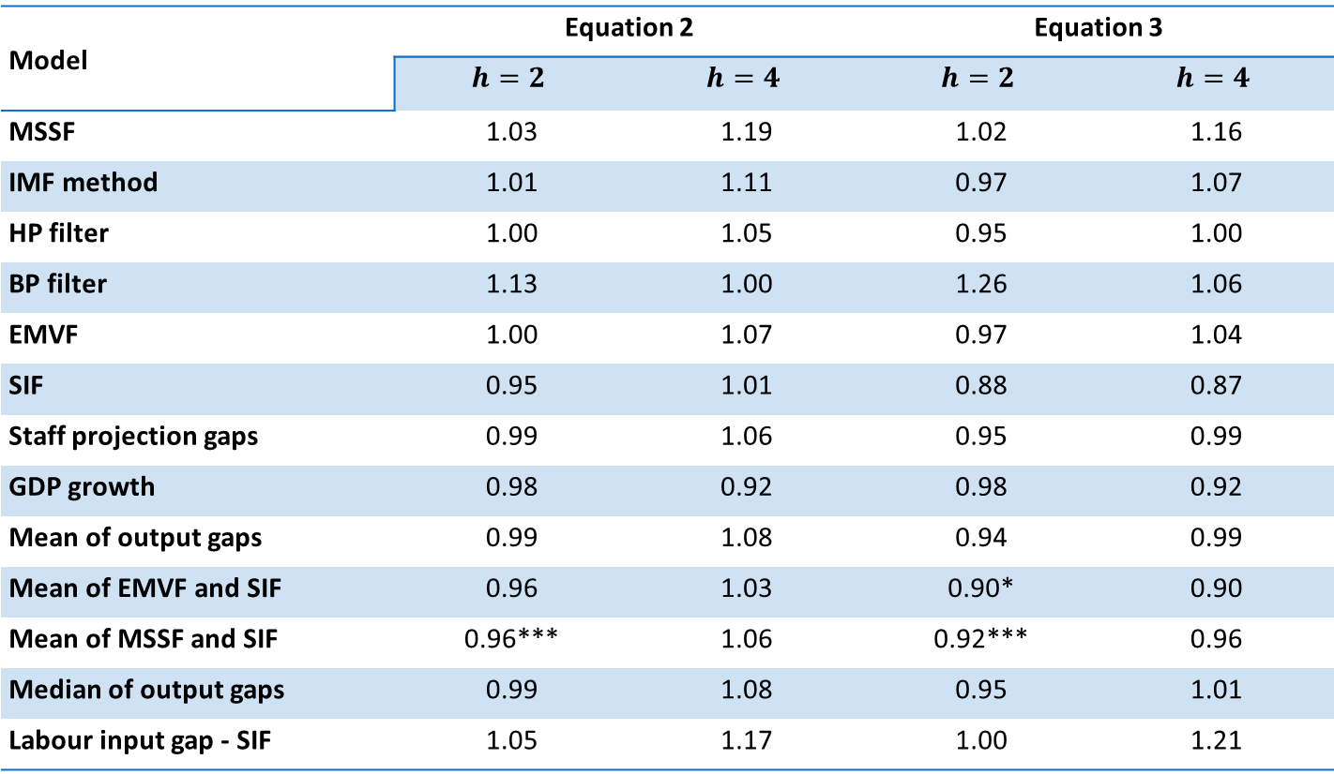
Table 3: Real-time forecasting assessment: Total inflation
Model | Equation 2 |  | Equation 3
 | $$h=2$$ | $$h=4$$ | $$h=2$$ | $$h=4$$
MSSF | 1.03 | 1.19 | 1.02 | 1.16
IMF method | 1.01 | 1.11 | 0.97 | 1.07
HP filter | 1.00 | 1.05 | 0.95 | 1.00
BP filter | 1.13 | 1.00 | 1.26 | 1.06
EMVF | 1.00 | 1.07 | 0.97 | 1.04
SIF | 0.95 | 1.01 | 0.88 | 0.87
Staff projection gaps | 0.99 | 1.06 | 0.95 | 0.99
GDP growth | 0.98 | 0.92 | 0.98 | 0.92
Mean of output gaps | 0.99 | 1.08 | 0.94 | 0.99
Mean of EMVF and SIF | 0.96 | 1.03 | 0.90* | 0.90
Mean of MSSF and SIF | 0.96*** | 1.06 | 0.92*** | 0.96
Median of output gaps | 0.99 | 1.08 | 0.95 | 1.01
Labour input gap - SIF | 1.05 | 1.17 | 1.00 | 1.21
Notes:
Shows ratios of RMSEs. For instance, 1.03 at the top left corner is the ratio of a model with both lags of inflation and lags of output gaps.
Eq (2) results is for cases where only lags of output gaps are included.
Eq (3) is for cases where both forecasted and lagged output gaps are included.
*Indicate levels of significance. Clark & McCracken (2009).
Output gaps do not bring much improvements in general.
In any case, in almost all cases improvements are not significant.
One exception, the combination of MSSF and SIF.
SIF does relatively well, and the combination of the two gives revisions that are much smaller than revisions to SIF. Helps significance.

Slide 19
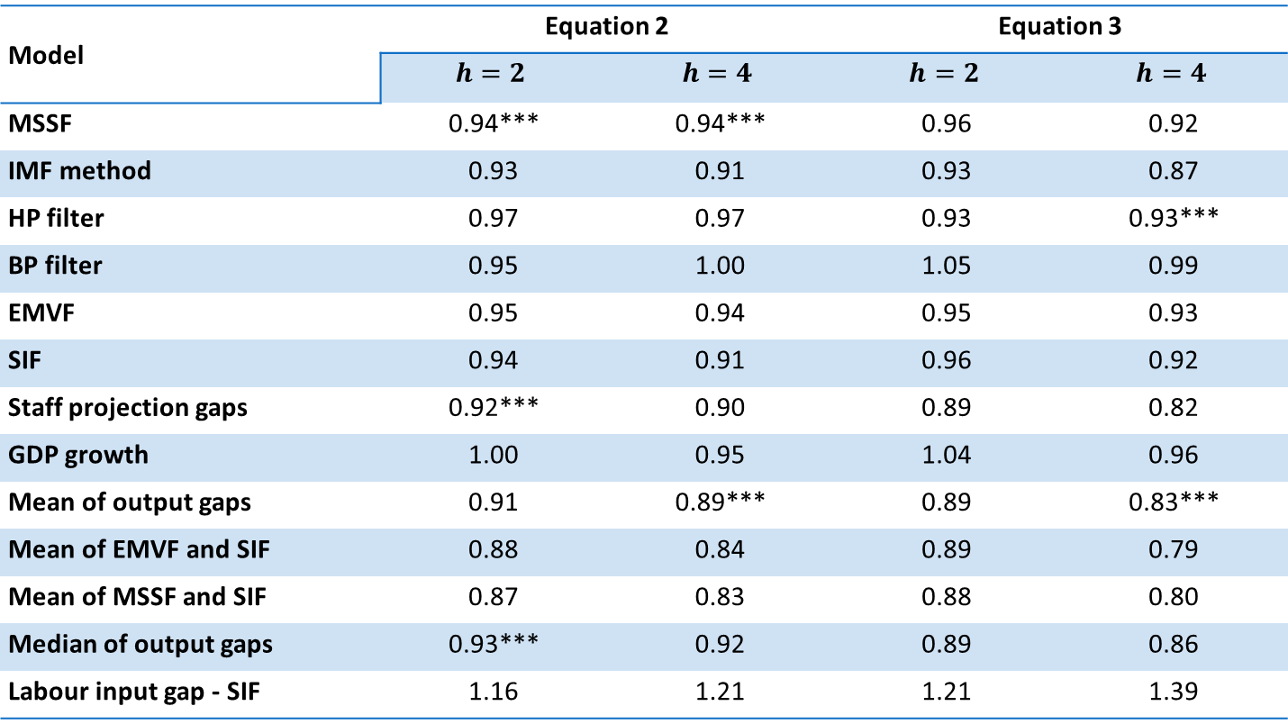
Table 4: Real-time forecasting assessment: Core inflation (CPI-trim)
Model | Equation 2 |  | Equation 3
 | $$h=2$$ | $$h=4$$ | $$h=2$$ | $$h=4$$
MSSF | 0.94*** | 0.94*** | 0.96 | 0.92
IMF method | 0.93 | 0.91 | 0.93 | 0.87
HP filter | 0.97 | 0.97 | 0.93 | 0.93***
BP filter | 0.95 | 1.00 | 1.05 | 0.99
EMVF | 0.95 | 0.94 | 0.95 | 0.93
SIF | 0.94 | 0.91 | 0.96 | 0.92
Staff projection gaps | 0.92*** | 0.90 | 0.89 | 0.82
GDP growth | 1.00 | 0.95 | 1.04 | 0.96
Mean of output gaps | 0.91 | 0.89*** | 0.89 | 0.83***
Mean of EMVF and SIF | 0.88 | 0.84 | 0.89 | 0.79
Mean of MSSF and SIF | 0.87 | 0.83 | 0.88 | 0.80
Median of output gaps | 0.93*** | 0.92 | 0.89 | 0.86
Labour input gap - SIF | 1.16 | 1.21 | 1.21 | 1.39
Notes:
Results for CPI-median not encouraging.
CPI-trim and common more encouraging.
CPI-trim results are shown in Table 4.
Output gaps appear to provide more useful information in this case, with most RMSE ratios below 1. SIF, Staff and simple combinations do relatively well.
Also some improvements are statistically significant.
Eq 2 and 3 results not very different.
Labour input gaps do not do better.

Slide 20
Conclusions

Slide 21
Main conclusions
New real-time database for Canada to assess ouptut gaps.
Output gap revisions large and biased towards smaller gaps (smaller potential output).
consistent with Grigoli et al (2015) and with Martin, Munyan and Wilson (2015)
Most output gap estimates do not appear to provide useful information − beyond that provided by lagged inflation − for forecasting total CPI inflation.
SIF might be an exception, especially in simple combinations.
Some output gap estimates may improve forecasts of core inflation measures.
Adding projected output gaps does not improve forecasts.
Labour input gaps do not do better than output gaps.

Slide 22
Conclusions
Some next steps:
Robustness checks.
E.g. in terms of methods used to forecast variables feeding in output gap estimates.
Consider other output gap measures.
Small sample of forecasts. Need to monitor future performance.
Develop methods that do better with marked economic slowdown.

Slide 23
Appendix

Slide 24
The Simplified Integrated Framework (SIF)

Slide 25
The Extended Multivariate Filter (EMVF)

Slide 26
Simplified and full versions of the IF

Slide 27
New measures of core inflation, year-over-year

Slide 28
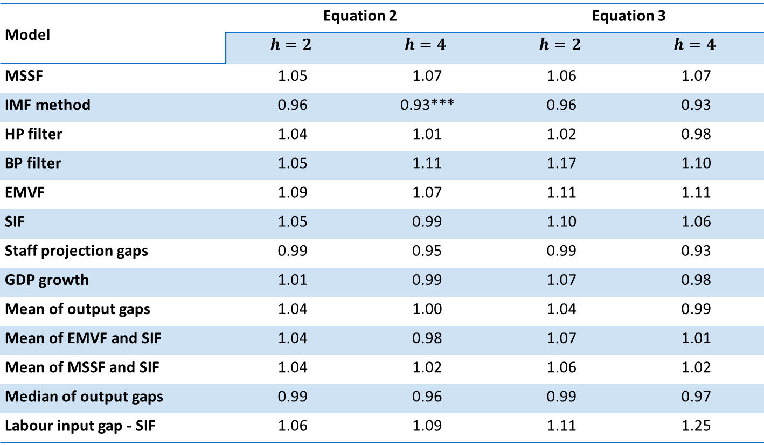
Real-time forecasting assessment: Core inflation (CPI-median)
Model | Equation 2 |  | Equation 3
 | $$h=2$$ | $$h=4$$ | $$h=2$$ | $$h=4$$
MSSF | 1.05 | 1.07 | 1.06 | 1.07
IMF method | 0.96 | 0.93*** | 0.96 | 0.93
HP filter | 1.04 | 1.01 | 1.02 | 0.98
BP filter | 1.05 | 1.11 | 1.17 | 1.10
EMVF | 1.09 | 1.07 | 1.11 | 1.11
SIF | 1.05 | 0.99 | 1.10 | 1.06
Staff projection gaps | 0.99 | 0.95 | 0.99 | 0.93
GDP growth | 1.01 | 0.99 | 1.07 | 0.98
Mean of output gaps | 1.04 | 1.00 | 1.04 | 0.99
Mean of EMVF and SIF | 1.04 | 0.98 | 1.07 | 1.01
Mean of MSSF and SIF | 1.04 | 1.02 | 1.06 | 1.02
Median of output gaps | 0.99 | 0.96 | 0.99 | 0.97
Labour input gap - SIF | 1.06 | 1.09 | 1.11 | 1.25

Slide 29

Real-time forecasting assessment: Core inflation (CPI-common)
Model | Equation 2 |  | Equation 3
 | $$h=2$$ | $$h=4$$ | $$h=2$$ | $$h=4$$
MSSF | 0.89 | 0.95 | 0.92 | 0.94
IMF method | 0.84 | 0.83 | 0.89 | 0.84
HP filter | 0.87* | 0.95 | 0.91 | 0.96
BP filter | 0.90 | 0.93 | 0.95 | 0.92
EMVF | 0.82*** | 0.92 | 0.89 | 0.93
SIF | 0.74 | 0.72 | 0.80 | 0.72
Staff projection gaps | 0.77 | 0.75 | 0.85 | 0.75
GDP growth | 1.03 | 0.87 | 0.98 | 0.86
Mean of output gaps | 0.78 | 0.81 | 0.84 | 0.81
Mean of EMVF and SIF | 0.73 | 0.73 | 0.80 | 0.73
Mean of MSSF and SIF | 0.76 | 0.77 | 0.81 | 0.78
Median of output gaps | 0.85 | 0.82 | 0.88 | 0.81
Labour input gap - SIF | 0.92 | 0.96 | 1.00 | 1.05

