Slide 1
Gavilán, Hernándes de Cos, Jimeno and Rojas Fiscal policy and external imbalances: A quantitative Evaluation for Spain
Discussion by Gernot Müller (Bonn)
Madrid, February 25, 2010

Slide 2
Interesting and provocative paper Proceeds in three steps
Quantitative account of economic boom in Spain during decade prior to crisis
Counterfactuals
Government consumption
Structural reform of labor and product market
Simulation of crisis and policy options

Slide 3
Framework: Real model of small open economy w/o nominal frictions
Households: OLG structure with immigration and social security
Investment good and final sector perfectly competitive, labor and product market not
Fiscal policy
Spending exogenous
Transfers and benefits depend on demographics
Labor tax adjusts to stabilize debt

Slide 4
1. Step: quantitative account
Explanatory factors, exogenous
Immigration flow
Path of real interest rates
Model explains change from 1998 to 2008 of
Foreign assets (cumulative current account )
Investment-output-ratio
Public debt-output-ratio

Slide 5
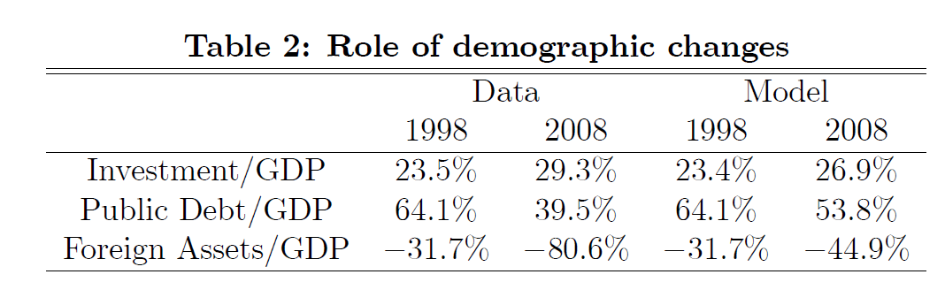
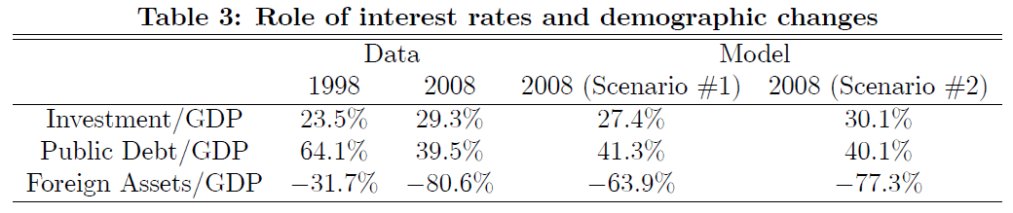
Model successful
Notes:
Demographic change
Expansion of workforce-> investment rises, partly financed from abroad (external debt rises)
Dependency ratio falls -> Public debt declines
Interest rate (scenario: permanent fall)
Investment and activity increases, tax revenues go up, public debt falls
Foreign debt increases strongly
What about other features of the data?

Slide 6
Other features of the data?
Model assessment limited to three observations
Other distinct features of 1998-2008 period
Housing (maybe cheap point)
Competitiveness
Model implication for real exchange rate?

Slide 7
Real appreciation
Notes:
Loss of competitiveness distinguished feature of the post-Euro/pre-crisis period in Spain
So please report this.
My guess: model does not too well here.
This motivates my next point: less relevant if I am wrong here

Slide 8
How to think about real interest rates?
Real interest rate determined by inflation for given ECB policy rate: r = i – π
Importance of EMU acknowledged by authors, but real model abstracts from inflation
Average inflation: 2 (EMU) vs 3 (Spain) percent
Rabanal (2009): inflation differential driven by technology shocks
Labor productivity growth in Spain far lower than in rest-of-EMU during last decade
Notes:
No Balassa-Samuelson: for once, tfp growth lower in spain
And: Rabanal: finds that trade-goods tfp accounts for small fraction of non-traded goods prices

Slide 9
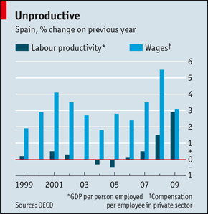

Slide 10
My experiment
Standard new Keynesian two country model
Spain within EMU
Common monetary policy: Taylor rule
Consider positive TFP shock in EMU, except for Spain: find all the features of the data and real appreciation…
Normative implication: external imbalance result of inappropriate monetary policy
Notes:
disclaimer

Slide 11
How Spain adjusts to EMU-TFP-shock
Notes:
Natural way to think about the data? Advantage: explains real exchange rate
This is not an alternative story, but a more complete one
If your model also explaines Reer appreciation fine, if not, need to reconsider your story

Slide 12
2. Step: counterfactuals
Structural reform: markup reduction stimulates growth and borrowing from abroad
Fiscal policy
Role for external imbalances?
Find very small effect of government consumption on external balance (in line with other studies, e.g., Corsetti and Müller 2008)
But you have richly specified OLG model: why not study tax policies and entitlement reform?

Slide 13
Step 3: crisis
Modeling the crisis: increased depreciation, lower productivity, increased government spending and transfers
Interesting result: tighter fiscal policy
Increases short-run output loss, but
Output gains after 2018
However: fiscal transmission may change during crisis (Corsetti, Meier, Müller 2010)

Slide 14
Nice paper
Impressive quantitative account of developments in Spain during last decade
Open issues
Competitiveness
Role of tax policies and entitlement reform for external balance
Effects of government spending during financial crisis

